Slide 1


2025 Beauty & Personal Care Trends
Understand what's new and next in consumer behaviour and the impact on beauty and personal care marketing and innovation.
Andrew McDougall
Global Beauty & Personal Care Analyst
September 2024
Read on mintel.com
Notes:
This slide is from 2025 Beauty & Personal Care Trends (https://clients.mintel.com/content/trend/2025-beauty-personal-care-trends#workspace_SpacesStore_15b98433-a573-4fe5-a827-eb550255b217)
© 2024 Mintel Group Ltd. All Rights Reserved. Confidential to Mintel.

Slide 2
Table Of Contents
1
(MY) KNOWLEDGE IS POWER
2
TURNING THE TIDE
3
THINK SLOW, MOVE FAST

Slide 3

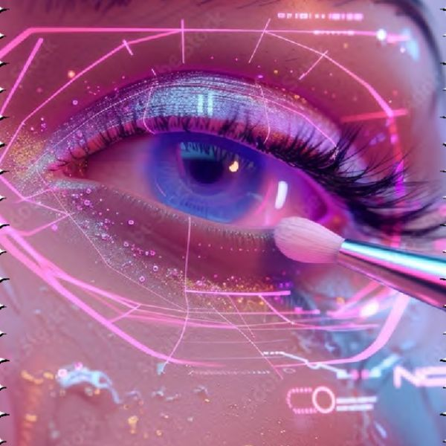

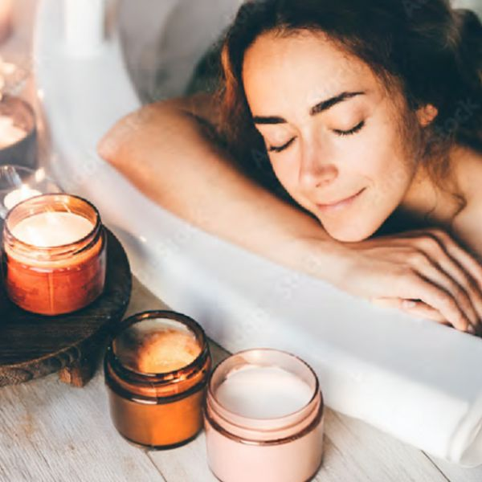
Introducing Mintel's 2025 Beauty & Personal Care Trends
(My) Knowledge is Power
Beauty is moving beyond algorithmic echo chambers, championing individuality and artistry. This change opposes uniform digital trends, urging consumers to showcase their unique identities. Brands innovate by celebrating diverse styles and nurturing self-expression.
Turning The Tide
Collaborating with green initiatives boosts brand credibility, appealing to savvy, eco-conscious consumers. By focusing on collaboration, brands align with future trends, standing out in a market eager for authentic sustainable innovation.
Think Slow, Move Fast
Consumers want to approach beauty with intention. How we interact with products becomes even more important and mindful. Embrace slow beauty with potent products and personalised consultations to address unique needs and deepen connections.
Read on mintel.com
Notes:
This slide is from 2025 Beauty & Personal Care Trends (https://clients.mintel.com/content/trend/2025-beauty-personal-care-trends#workspace_SpacesStore_06424b42-86a8-44e0-9d2b-9945a2f6b81b)
© 2024 Mintel Group Ltd. All Rights Reserved. Confidential to Mintel.

Slide 4
The methodology of the 2025 Global Beauty & Personal Care Trends
Built upon Mintel expertise and tools
The 2025 Global Beauty & Personal Care Trends are built on the base of Mintel's seven Trend Drivers: Wellbeing, Experiences, Surroundings, Rights, Technology, Identity and Value.
In addition, they are supported by Mintel's extensive libraries of global consumer data, product launches and inspiring marketing campaigns.
Anchored in current events
The predictions are built around buzzworthy topics that have the potential to upset the status quo in the beauty and personal care industry in 2025 and thereafter.
Going forward, Mintel's analysts will monitor how new events and innovations impact these trends.
Forecast for evolutions in the next 10 years
Mintel's experts have predicted how these Trends will play out over the next five years and beyond in three time periods:
  Now: the coming 12 months (2025)
  Next: 2-5 years (2026-30)
  Future: 5+ years (2030 onward), presented as a blue-sky 'day in the life' story of a fictional character
Read on mintel.com
Notes:
This slide is from 2025 Beauty & Personal Care Trends (https://clients.mintel.com/content/trend/2025-beauty-personal-care-trends#workspace_SpacesStore_d6aec2cf-d03f-40a6-aa80-b8e0b8db27ae)
© 2024 Mintel Group Ltd. All Rights Reserved. Confidential to Mintel.

Slide 5
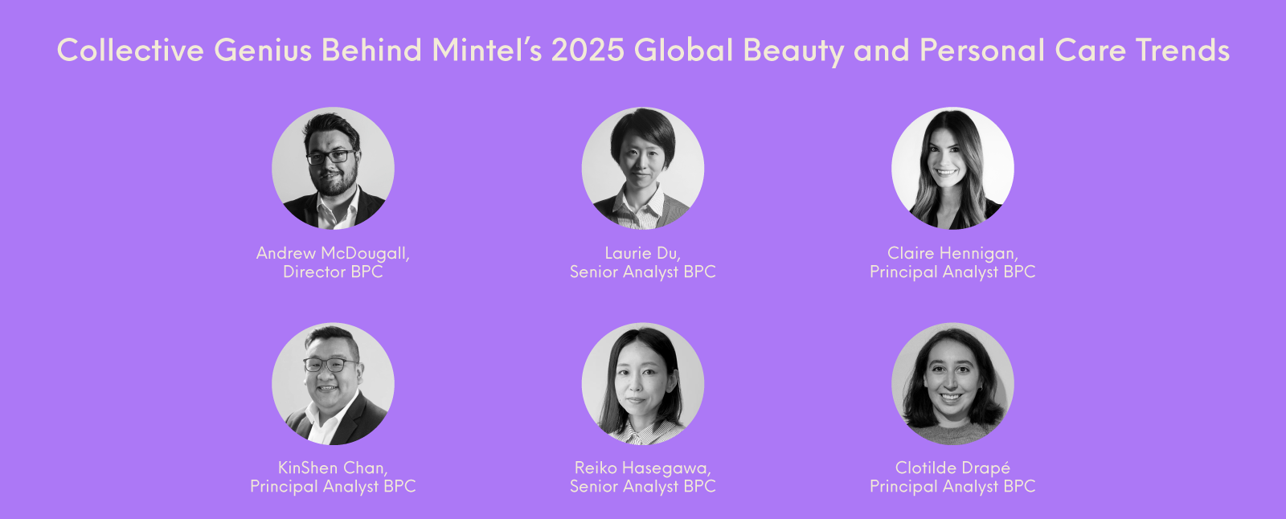
Time for a profound transformation in the BPC landscape
Speak to your Account Manager to book a meeting to discuss how the 2025 Beauty & Personal Care Trends will impact your business.
Read on mintel.com
Notes:
This slide is from 2025 Beauty & Personal Care Trends (https://clients.mintel.com/content/trend/2025-beauty-personal-care-trends#workspace_SpacesStore_ed54fe4f-8479-450d-9a8a-a6b12de2e1c5)
© 2024 Mintel Group Ltd. All Rights Reserved. Confidential to Mintel.

Slide 6

Discover all our 2025 Trends
Our 2025 Trends analyse consumer behaviour across categories and markets to reveal the macro trends impacting your business. Discover what's changing, why and key opportunities for your brand.
Check out the full suite of 2025 Trends now!
Read on mintel.com
Notes:
This slide is from 2025 Beauty & Personal Care Trends (https://clients.mintel.com/content/trend/2025-beauty-personal-care-trends#workspace_SpacesStore_35ac9aa4-ed97-4ddc-90db-9fdf23698add)
© 2024 Mintel Group Ltd. All Rights Reserved. Confidential to Mintel.

Slide 7

(MY) KNOWLEDGE IS POWER
Read on mintel.com
Notes:
This slide is from 2025 Beauty & Personal Care Trends (https://clients.mintel.com/content/trend/2025-beauty-personal-care-trends#workspace_SpacesStore_667dcf35-3cb3-499b-8aee-51bbdf9b1b53)
© 2024 Mintel Group Ltd. All Rights Reserved. Confidential to Mintel.

Slide 8
Empower beauty choices
Empowered consumers are taking charge of their beauty choices, prioritising brands that offer transparency, authenticity and alignment with their personal values.
Beauty has become a bold display of individuality. Consumers seek products that reflect unique identities, driving demand for inclusive ranges. Beauty transcends personalisation, celebrating diversity and using products as a tool for self-expression. This shift pushes brands to innovate with effective and personal solutions, embracing beauty as an identity celebration.
With online resources, people are more experimental and creative. This empowerment promotes a personalised, ethical and effective beauty approach, influencing purchasing behaviours and steering the industry towards innovation, inclusivity and responsibility. Brands embracing these changes will thrive, creating a beauty ecosystem reflecting diverse needs and values.
Read on mintel.com
Notes:
This slide is from 2025 Beauty & Personal Care Trends (https://clients.mintel.com/content/trend/2025-beauty-personal-care-trends#workspace_SpacesStore_d50f2d07-c634-44cf-a58f-12530715df28)
© 2024 Mintel Group Ltd. All Rights Reserved. Confidential to Mintel.

Slide 9
What's now?
Read on mintel.com
Notes:
This slide is from 2025 Beauty & Personal Care Trends (https://clients.mintel.com/content/trend/2025-beauty-personal-care-trends#workspace_SpacesStore_67017c60-b697-43ef-8980-3eed9a490155)
© 2024 Mintel Group Ltd. All Rights Reserved. Confidential to Mintel.

Slide 10
Consumers demand self-expression and control over choices
Consumers prioritise personal control, brand value alignment and individuality, highlighting diverse consumer motivations globally.
have control
align values
express themselves
95%
81%
63%
of Brazilian adults* agree that it's important to them to have control over their lives
of Chinese adults* agree that making sure a brand's values align with their own is a top priority when buying a product
of Italian adults* agree that being able to express their individuality is a top priority for them in life
* taken from Mintel's Global Consumer
Base: Brazil, Italy: 1,000 internet users aged 16+ in each market; China: 1,000 internet users aged 18+
Source: Kantar Profiles/Mintel, March 2024
Read on mintel.com
Notes:
* taken from Mintel's Global Consumer
Source: Kantar Profiles/Mintel, March 2024
This slide is from 2025 Beauty & Personal Care Trends (https://clients.mintel.com/content/trend/2025-beauty-personal-care-trends#workspace_SpacesStore_fb6ad756-378e-4cb1-84a8-f857f5114af9)
© 2024 Mintel Group Ltd. All Rights Reserved. Confidential to Mintel.

Slide 11
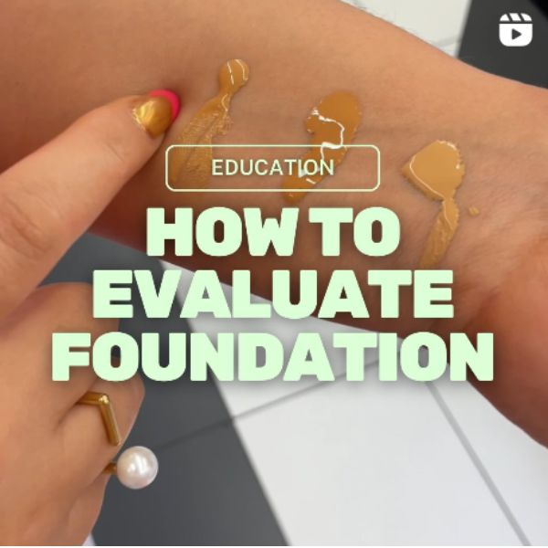
Early indicators of self-expression
Social media has become key for brands to understand consumers and vice versa, with influencers like The Lipstick Lesbians offering industry insights. This empowers informed consumer choices and increases professional treatment popularity among younger generations.
In China and Japan, personalised services are differentiating brands, as seen with POLA's APEX line using Motion Scan Technology for tailored solutions. Brands should invest in biotech innovations for clinical results, precision and consumer loyalty to achieve commercial success.
Beauty companies can enhance consumer engagement and brand differentiation by leveraging social media and influencer partnerships to gain insights and reach younger demographics. Investing in personalised services and biotech innovations ensures tailored solutions and clinical-level results, fostering consumer loyalty and commercial success.
The Lipstick Lesbians break down how to evaluate beauty products
Read on mintel.com
Notes:
This slide is from 2025 Beauty & Personal Care Trends (https://clients.mintel.com/content/trend/2025-beauty-personal-care-trends#workspace_SpacesStore_c8950d1c-2ab5-4f38-9611-d5413400157a)
© 2024 Mintel Group Ltd. All Rights Reserved. Confidential to Mintel.

Slide 12
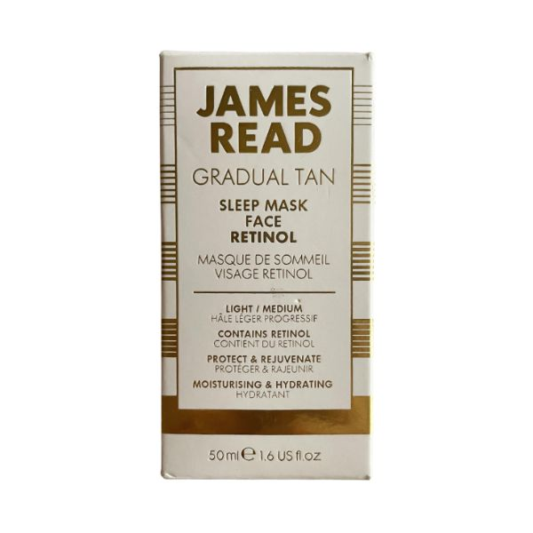
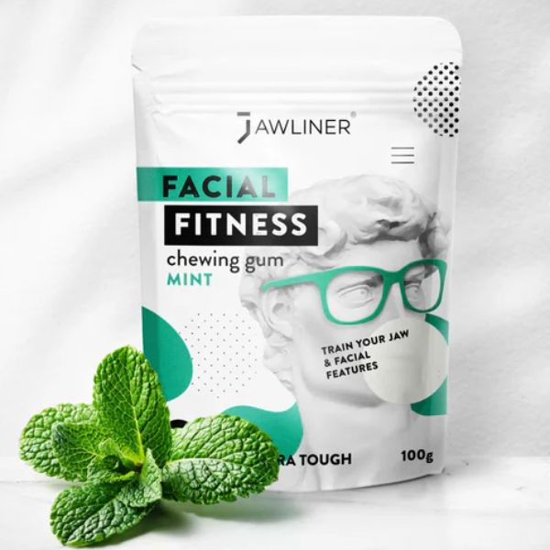
Viral beauty trends offer minimal effort with maximum results
The beauty landscape is increasingly driven by informed and empowered consumers who prioritise functional efficacy and creativity in their routines.
There has been a shift towards smart, customised beauty practices that leverage personal knowledge and technological advancements.
Beauty consumers work smarter, not harder, repurposing products like self-tanners as bronzers or using Vaseline for skin 'slugging', maximising effectiveness with minimal effort.
James Read Gradual Tan Sleep Mask Face Retinol offers a passive beauty option
Aligning with looksmaxxing* trends, fitness chewing gum claims to define the jawline
* looksmaxxing refers to the social media trend centred around the 'maximisation' of one's appearance
Source: Jawliner
Read on mintel.com
Notes:
* looksmaxxing refers to the social media trend centred around the 'maximisation' of one's appearance
Source: Jawliner
This slide is from 2025 Beauty & Personal Care Trends (https://clients.mintel.com/content/trend/2025-beauty-personal-care-trends#workspace_SpacesStore_1c272744-7fc6-4f9d-8866-5b8ed9c45ea2)
© 2024 Mintel Group Ltd. All Rights Reserved. Confidential to Mintel.

Slide 13
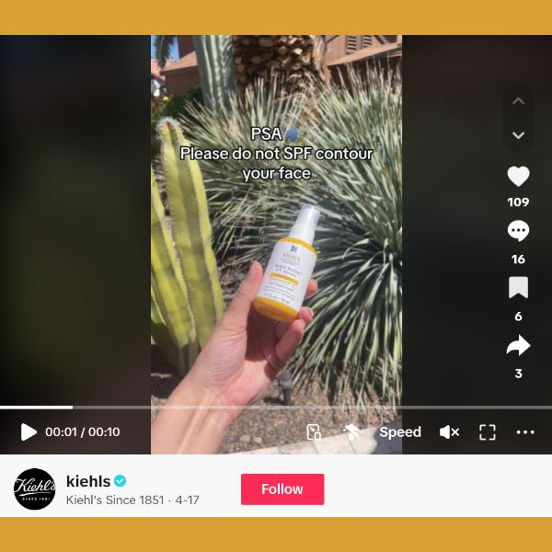

Guide consumers towards a safer beauty journey
Amid beauty hacking trends fuelled by social media, brands can act as educational partners, helping consumers protect and care for themselves. By providing reliable guidance, brands empower informed, mindful beauty choices.
They can regain consumer loyalty by emphasising their dedication to their values. In China, for instance, 81% of adults* say making sure a brand's values align with their own is a top priority when purchasing a product.
Kiehl's warns against SPF contouring on TikTok
The Ordinary urges tweens and teens to avoid skin-damaging routines
* taken from Mintel's Global Consumer
Read on mintel.com
Notes:
* taken from Mintel's Global Consumer
This slide is from 2025 Beauty & Personal Care Trends (https://clients.mintel.com/content/trend/2025-beauty-personal-care-trends#workspace_SpacesStore_fb258e1d-dc81-4f77-a3f8-c6999e1f8e44)
© 2024 Mintel Group Ltd. All Rights Reserved. Confidential to Mintel.

Slide 14
Knowledge fuels the surge in preventative beauty solutions
Gen Zers show a growing interest in anti-ageing products, presenting an opportunity to focus on preventing skin issues before they appear. For instance, L'Oréal's MELA B3 range helps intercept excess melanin at an early stage of its production before it marks the skin.
Leveraging educational marketing to inform Gen Z about the benefits of early skincare routines can enhance brand credibility and engagement.
Base: US: 2,000 internet users aged 18+
Source: Kantar Profiles/Mintel, February 2024, March 2023, March 2022
Read on mintel.com
Notes:
Source: Kantar Profiles/Mintel, February 2024 [1], March 2023 [2], March 2022 [3]
[1] https://data.mintel.com/databook/facial-skincare-us-2024/question/NET_Q7a_9151?country=3&d=generation
[2] https://data.mintel.com/databook/1155695/question/NET_Q13a_7035?country=3&d=generation
[3] https://data.mintel.com/databook/1102815/question/NET_Q13a_4985?country=3&d=generation
This slide is from 2025 Beauty & Personal Care Trends (https://clients.mintel.com/content/trend/2025-beauty-personal-care-trends#workspace_SpacesStore_1e6a3d38-c81f-4089-81f0-bc9725aabbc0)
© 2024 Mintel Group Ltd. All Rights Reserved. Confidential to Mintel.

Slide 15
What's next?
Read on mintel.com
Notes:
This slide is from 2025 Beauty & Personal Care Trends (https://clients.mintel.com/content/trend/2025-beauty-personal-care-trends#workspace_SpacesStore_0db234e9-b4bc-450e-bb69-4e62fb20039a)
© 2024 Mintel Group Ltd. All Rights Reserved. Confidential to Mintel.

Slide 16
Embrace individuality and innovation in beauty solutions
Focus on developing hyper-personalised and targeted products to meet the increasing demand from consumers eager to invest in tailored beauty solutions and innovations.
hyper-personalisation
age relevant
early adopters
62%
63%
74%
of US BPC buyers are interested in hyper-personalised BPC products, and 28% would be willing to pay more for them
of UK adults* aged 16-44 want more beauty products that are specifically designed for their age
of Chinese adults* like to be among the first to try new technologies
* taken from Mintel's Global Consumer
Base: US: 1,973 internet users aged 18+ who buy select personal care products; UK: 1,000 internet users aged 16+; China: 1,000 internet users aged 18+
Source: Kantar Profiles/Mintel, July 2022, March 2024
Read on mintel.com
Notes:
* taken from Mintel's Global Consumer
Source: Kantar Profiles/Mintel, July 2022, March 2024
This slide is from 2025 Beauty & Personal Care Trends (https://clients.mintel.com/content/trend/2025-beauty-personal-care-trends#workspace_SpacesStore_36ea0641-d0a3-41d6-a16c-faa9e2babf11)
© 2024 Mintel Group Ltd. All Rights Reserved. Confidential to Mintel.

Slide 17
Redefining health, safety and individuality in a new era
The convergence of beauty with nutrition will deepen as more consumers recognise the gut-mind-skin connection and the impact of diet on their appearance. Beauty brands will begin to market products as health focused, addressing concerns from parents and institutions over younger generations' beauty obsessions.
Amid these shifts, the focus on ingredient safety will expand, with consumers paying more attention to environmental factors such as water and air quality. To combat the algorithmic echo chambers of aesthetic sameness, the next phase will see a resurgence of individuality and artistry.
Companies will need to differentiate not only with ingredients but also through advanced technologies like encapsulation and sebum RNA monitoring, ensuring that their products offer noticeable, tangible benefits that stand out in a crowded market.
beauty from within
92%
of Philippine adults* agree that a healthy diet plays an equally important role as beauty products in enhancing beauty
* taken from Mintel's Global Consumer
Base: Philippines: 1,000 internet users aged 18+
Source: Kantar Profiles/Mintel, March 2024
Read on mintel.com
Notes:
* taken from Mintel's Global Consumer
Source: Kantar Profiles/Mintel, March 2024
This slide is from 2025 Beauty & Personal Care Trends (https://clients.mintel.com/content/trend/2025-beauty-personal-care-trends#workspace_SpacesStore_7ffd6b8c-6acc-4a2f-8179-c312093cc538)
© 2024 Mintel Group Ltd. All Rights Reserved. Confidential to Mintel.

Slide 18
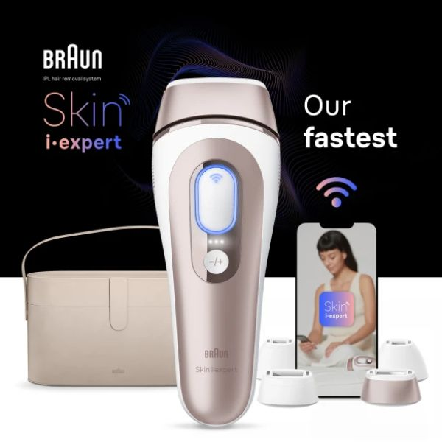
Convenience-obsessed consumers will demand real-time insights…
As the (My) Knowledge is Power Trend evolves, beauty innovations will increasingly fuse with technology, providing consumers with real-time insights into their skin's needs.
Products like Braun's Skin iExpert Smart IPL, which offers personalised guidance during use, are just the beginning.
Expect a surge in devices that offer on-the-spot analysis and results, empowering users to make informed decisions instantly.
Beauty brands can seize commercial opportunities by developing smart devices that offer real-time skin analysis/personalised guidance, leveraging advanced technologies like AI to enhance their products.
Collaborations with tech companies can accelerate innovation and highlight the convenience and personalisation these devices offer. Engaging consumers through educational content and interactive experiences will strengthen brand loyalty and position brands as leaders in beauty tech.
A connected app enables real-time expert guidance and progress tracking
Source: Braun
Read on mintel.com
Notes:
Source: Braun [1]
[1] https://us.braun.com/en-us/female-hair-removal/ipl/skin-i-expert-ipl-pl7387?&utm_source=google&utm_medium=cpc&utm_term=braun+smart+ipl&utm_campaign=Google_Brand-DTC_0_None_Skin+i-Expert_Phrase&utm_content=s_dc%7Cpcrid%7C679769260269&gad_source=1&gclid=CjwKCAjw8rW2BhAgEiwAoRO5rI-0P87Hh8Q-MBNQDhT9v7gTVLnRwEXwuW2YF05zVTJn5XYQNeg61BoCj_UQAvD_BwE&gclsrc=aw.ds
This slide is from 2025 Beauty & Personal Care Trends (https://clients.mintel.com/content/trend/2025-beauty-personal-care-trends#workspace_SpacesStore_e6f32e86-a700-45c5-a135-bdedb36555cb)
© 2024 Mintel Group Ltd. All Rights Reserved. Confidential to Mintel.

Slide 19
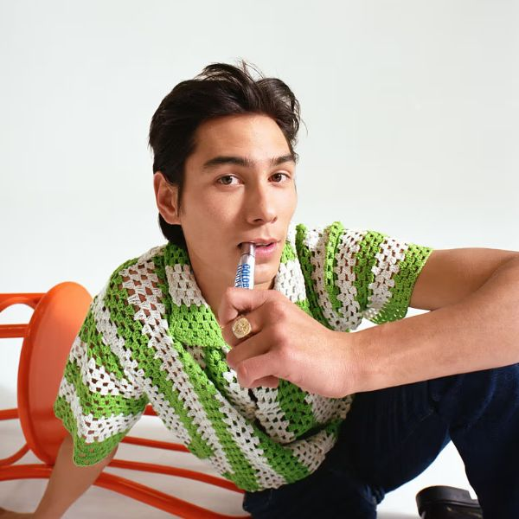
…but an overwhelming amount of information spurs wellness fatigue
As wellness fatigue sets in, consumers will grow weary of complex, multistep routines and the pressure to follow rigid guidelines, potentially leading to stress and conditions like 'dermorexia' (obsessive skincare behaviour, fuelled by a fixation on maintaining a youthful appearance).
Brands can capitalise on trends such as 'anti-wellness', 'pro-ageing' and inclusivity, offering products that cater to diverse consumer needs and preferences. By focusing on simplicity, transparency and community engagement, these brands provide alternatives to rigid beauty norms, appealing to consumers seeking authenticity and individuality in their beauty routines.
Show authenticity and 'real beauty', without coming across as virtue signalling. Brands using filters and image editing need to own it.
Good Weird rejects beauty standards in its marketing
Source: Hypebeast
Read on mintel.com
Notes:
Source: Hypebeast [1]
[1] https://hypebeast.com/2023/3/good-weird-genderless-beauty-skincare-brand-launch-evan-mock-creative-director
This slide is from 2025 Beauty & Personal Care Trends (https://clients.mintel.com/content/trend/2025-beauty-personal-care-trends#workspace_SpacesStore_3274825c-1beb-4bee-8f89-2d4e9a26f5ab)
© 2024 Mintel Group Ltd. All Rights Reserved. Confidential to Mintel.

Slide 20
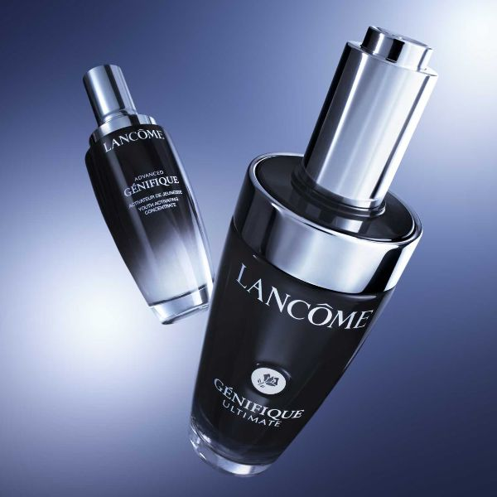
Demand for unbiased clinical results and visual proof drives beauty innovation
Cydolia and Lancôme have joined forces to demonstrate the efficacy of the new Génifique Ultimate serum with advanced tech-based evidence. This collaboration leverages clinical trials to provide credible evidence of the product's performance, complemented by unbiased before-and-after visualisations.
This partnership underscores the growing consumer demand for such reassurance, with 70% of recent dermocosmetics buyers valuing on-pack clinical trial data.
Beauty brands can leverage this trend by incorporating rigorous clinical validations and transparent visual evidence into their marketing strategies, thereby enhancing consumer trust and influencing purchasing decisions.
Cydolia and Lancôme for Génifique Ultimate
Read on mintel.com
Notes:
This slide is from 2025 Beauty & Personal Care Trends (https://clients.mintel.com/content/trend/2025-beauty-personal-care-trends#workspace_SpacesStore_c5439979-cff0-455d-826d-b1bcefc5a14e)
© 2024 Mintel Group Ltd. All Rights Reserved. Confidential to Mintel.

Slide 21

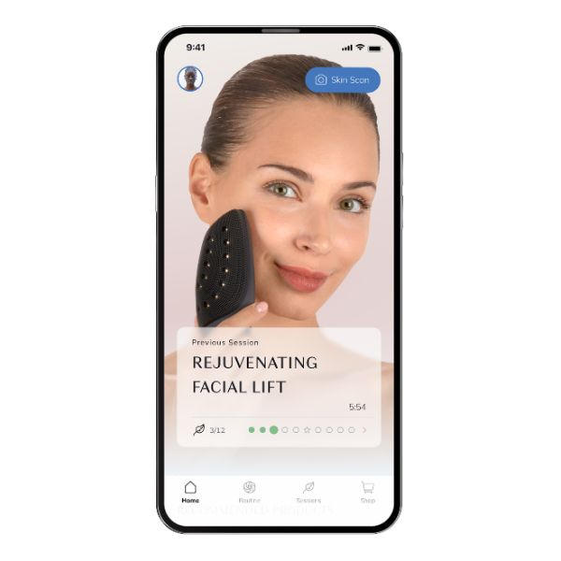
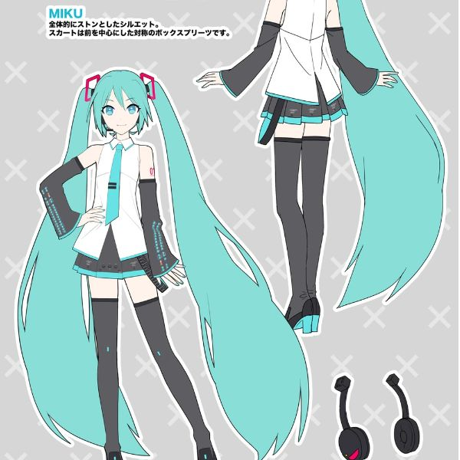
Leveraging advanced technology to offer personalised beauty solutions
The future of personalised beauty will showcase how technology can create tailored experiences and products, enhancing consumer engagement and satisfaction.
AI-assisted wig creation
Hairtelligence from Parfait makes high-quality, personalised wigs using AI technology to produce accurate measurements and hairstyles for anyone.
Engineered skincare
GESKE German Beauty Tech provides customisable beauty tech with proven skincare expertise driven by AI technology.
Non-human idols
'Hatsune Miku is playing Coachella, but she's not human'. She's a totally digital creation. Her music – mostly synthesizer-heavy dance pop – is created from software developed by Japan-based technology company Crypton Future Media.
Source: Vocaloid
Read on mintel.com
Notes:
Source: Vocaloid [1]
[1] https://vocaloid.fandom.com/wiki/Hatsune_Miku?file=Hatsune+Miku+SP+concept+artwork.jpg
This slide is from 2025 Beauty & Personal Care Trends (https://clients.mintel.com/content/trend/2025-beauty-personal-care-trends#workspace_SpacesStore_3dc961cb-9bfd-46ca-a9af-e7726f712558)
© 2024 Mintel Group Ltd. All Rights Reserved. Confidential to Mintel.

Slide 22
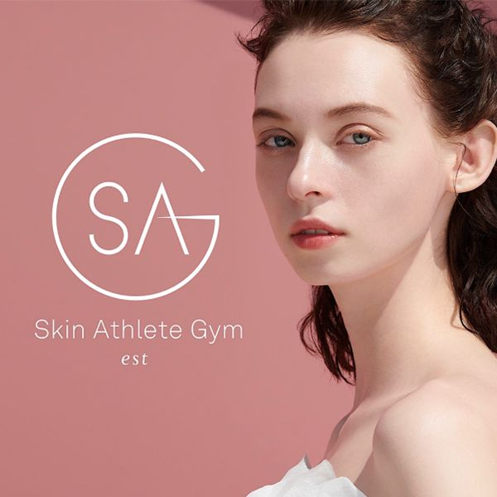
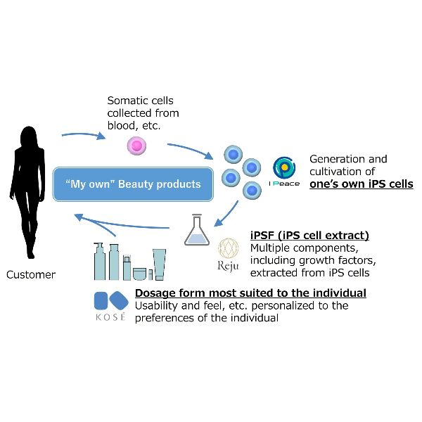
Unlock smart personalisation
Customised and scientifically backed products and services meet the growing consumer demand for personalised care and enhanced customer satisfaction and loyalty.
RNA skin analysis
Est Skin Athlete Gym develops personalised luxury solutions utilising RNA analysis. It offers skincare lessons and online/offline counselling to complement this.
Stem cells
Kosé will form a technical alliance with i-PACE and Reju for personalised beauty products using iPS cells.
Read on mintel.com
Notes:
This slide is from 2025 Beauty & Personal Care Trends (https://clients.mintel.com/content/trend/2025-beauty-personal-care-trends#workspace_SpacesStore_9ce2ac0b-fd8f-4498-bf1d-4d5ec5bb9dd5)
© 2024 Mintel Group Ltd. All Rights Reserved. Confidential to Mintel.

Slide 23
What will happen in the future…
Read on mintel.com
Notes:
This slide is from 2025 Beauty & Personal Care Trends (https://clients.mintel.com/content/trend/2025-beauty-personal-care-trends#workspace_SpacesStore_86d45531-c7ae-452b-abf1-90a3f86d77cc)
© 2024 Mintel Group Ltd. All Rights Reserved. Confidential to Mintel.

Slide 24

A day in the life…
Read on mintel.com
Notes:
This slide is from 2025 Beauty & Personal Care Trends (https://clients.mintel.com/content/trend/2025-beauty-personal-care-trends#workspace_SpacesStore_9df2ff0a-df67-45bf-8115-3e41dda29c45)
© 2024 Mintel Group Ltd. All Rights Reserved. Confidential to Mintel.

Slide 25

A day in the life…
As the sun rises, Jane starts her day by slipping on her AR glasses, a staple in her morning routine. Instantly, her virtual assistant appears, offering a personalised skincare regimen based on the weather forecast and real-time analysis of her skin.
Jane's journey through her beauty ritual is accompanied by a virtual AI influencer who guides her through makeup application, offering tips tailored specifically to her preferences and skin type. This digital mentor resonates with Jane's generation, providing advice that feels both personal and precise, building a community around shared insights and experiences.
Throughout the day, Jane's smartwatch monitors her stress levels, seamlessly adjusting her skincare routine. During a hectic meeting, it suggests a calming serum, knowing exactly when her skin needs a boost.
Read on mintel.com
Notes:
This slide is from 2025 Beauty & Personal Care Trends (https://clients.mintel.com/content/trend/2025-beauty-personal-care-trends#workspace_SpacesStore_d98f5758-1243-4f56-9542-f8cecc998227)
© 2024 Mintel Group Ltd. All Rights Reserved. Confidential to Mintel.

Slide 26
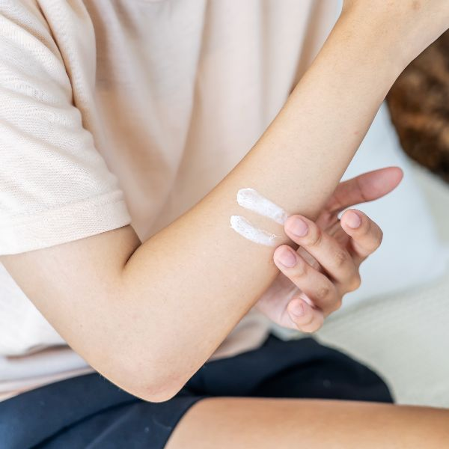
A day in the life…
Later, her AR glasses notify her of a slight increase in UV exposure, prompting an automatic adjustment in her SPF application schedule.
In the evening, Jane indulges in a skincare treatment developed with ingredients derived from her own cells. This bespoke approach ensures her products are not just effective but also perfectly compatible with her unique biology.
As she unwinds, Jane connects with an online community where virtual influencers and fellow skincare enthusiasts share insights and experiences, reinforcing a sense of belonging and collective growth.
The day concludes with Jane reflecting on the seamless integration of technology into her life. Beauty, once a generic routine, has become a deeply personal and informed experience, echoing the revolution of personalisation and AI-driven innovation that defines her generation's approach to beauty and wellness.
Read on mintel.com
Notes:
This slide is from 2025 Beauty & Personal Care Trends (https://clients.mintel.com/content/trend/2025-beauty-personal-care-trends#workspace_SpacesStore_605266d9-e7de-450c-9fdf-d8ff4acd66e6)
© 2024 Mintel Group Ltd. All Rights Reserved. Confidential to Mintel.

Slide 27
TURNING THE TIDE
Read on mintel.com
Notes:
This slide is from 2025 Beauty & Personal Care Trends (https://clients.mintel.com/content/trend/2025-beauty-personal-care-trends#workspace_SpacesStore_6a0eb006-9581-42a5-82f4-1edcf66e8ba4)
© 2024 Mintel Group Ltd. All Rights Reserved. Confidential to Mintel.

Slide 28

Shifting beauty: the path to sustainable consumer choices
In 2025, while consumers prioritise beauty products that deliver results, sustainability is a crucial differentiator, rather than the primary purchase driver.
Consumers value items that 'do no harm' and assist in adapting to environmental changes. To capitalise on this, brands must transcend their offerings by integrating biotech innovations and demonstrating a commitment to safety through sustainable methods.
Brands can effectively influence consumer behaviour by focusing on transparency, storytelling and community engagement. Emphasising regenerative practices and ethical considerations can build emotional connections, making sustainability a decisive factor.
Moreover, creating subtle nudges that make sustainable choices more convenient can encourage eco-conscious consumption. This strategy links sustainability to safety, driving a shift towards more responsible beauty consumption.
Read on mintel.com
Notes:
This slide is from 2025 Beauty & Personal Care Trends (https://clients.mintel.com/content/trend/2025-beauty-personal-care-trends#workspace_SpacesStore_20b84a8e-a9a7-4cc5-a576-08bb94ac409c)
© 2024 Mintel Group Ltd. All Rights Reserved. Confidential to Mintel.

Slide 29
What's now?
Read on mintel.com
Notes:
This slide is from 2025 Beauty & Personal Care Trends (https://clients.mintel.com/content/trend/2025-beauty-personal-care-trends#workspace_SpacesStore_1717efc7-4b3d-48e8-a11c-cbddd41efa64)
© 2024 Mintel Group Ltd. All Rights Reserved. Confidential to Mintel.

Slide 30
Consumers demand ethical leadership
Consumers increasingly prioritise ethical behaviour, environmental responsibility and local sourcing in their purchasing decisions, expecting brands to lead in these areas.
expectations
ethical importance
local priority
61%
78%
57%
of US adults* expect brands to take the lead on addressing environmental issues
of Thai adults* are opposed to buying from companies that behave unethically (eg misleading consumers, mistreating employees)
of Spanish adults* agree that local companies/brands are their first choice when shopping
* taken from Mintel's Global Consumer
Base: US, Thailand: 1,000 internet users aged 18+ in each market; Spain: 1,000 internet users aged 16+
Source: Kantar Profiles/Mintel, March 2024
Read on mintel.com
Notes:
* taken from Mintel's Global Consumer
Source: Kantar Profiles/Mintel, March 2024
This slide is from 2025 Beauty & Personal Care Trends (https://clients.mintel.com/content/trend/2025-beauty-personal-care-trends#workspace_SpacesStore_4ebcfc88-26b8-44f6-9033-ff126821f444)
© 2024 Mintel Group Ltd. All Rights Reserved. Confidential to Mintel.

Slide 31

Sustainability as the new standard
In 2025, sustainability in beauty is no longer optional; it's a baseline expectation. Consumers are demanding products that not only deliver on performance but also prioritise environmental responsibility.
A new wave of brands embrace green chemistry and use sustainably sourced botanicals, ensuring that efficacy isn't sacrificed for sustainability. Brands can lead the charge by merging science-driven expertise with eco-friendly practices.
As climate change becomes more evident, there's growing pressure on beauty brands to create solutions that address this reality. Biotech ingredients are becoming more common. However, consumer awareness of these innovations remains limited, signalling an opportunity for brands to better educate their audiences.
L'Oréal/Debut's partnership aims to develop bio-identical ingredients
Read on mintel.com
Notes:
This slide is from 2025 Beauty & Personal Care Trends (https://clients.mintel.com/content/trend/2025-beauty-personal-care-trends#workspace_SpacesStore_3ab0eb27-123d-4820-85f9-5472ca308bfb)
© 2024 Mintel Group Ltd. All Rights Reserved. Confidential to Mintel.

Slide 32
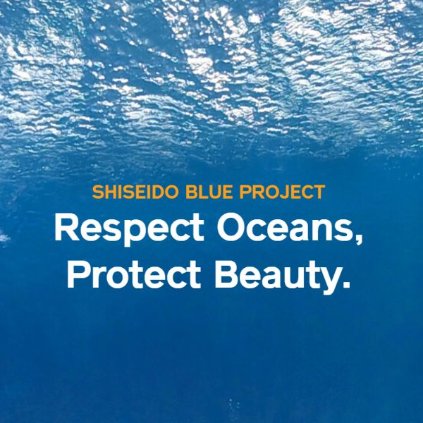
Commit to 'leave no trace' practices
The 'leave no trace' concept emphasises minimising environmental impact by ensuring products/practices are sustainable throughout their lifecycle (ingredients, packaging, production methods and minimalist formulations).
In markets like China and Japan, beauty brands are leading with innovative sustainability practices tailored to local consumer needs, shifting towards climate-adaptive products, designed to tackle specific environmental challenges.
Brands also focus on multifunctional formulations that meet diverse consumer needs while conserving resources. This progressive approach not only satisfies ethical/sustainable consumer demands but also establishes companies as front-runners in environmental stewardship.
Through localised strategies and consumer involvement, brands can redefine sustainable beauty standards, showing that responsible practices can drive innovation and loyalty.
Shiseido's Blue Project includes beach clean-ups and ocean conservation efforts
Read on mintel.com
Notes:
This slide is from 2025 Beauty & Personal Care Trends (https://clients.mintel.com/content/trend/2025-beauty-personal-care-trends#workspace_SpacesStore_d73fb940-7eae-4b93-baa6-e28ce73ffc13)
© 2024 Mintel Group Ltd. All Rights Reserved. Confidential to Mintel.

Slide 33
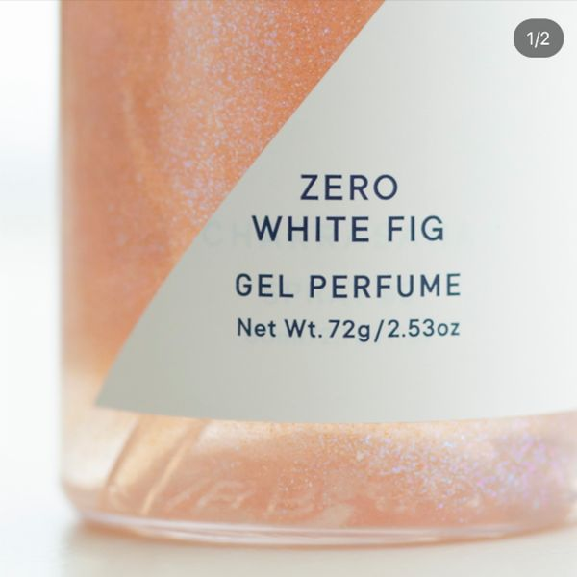
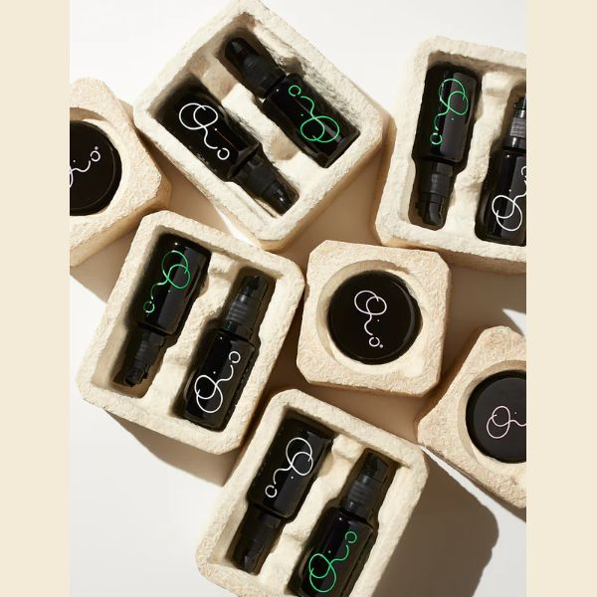
Consumers seek sustainable solutions when individual benefits are clear
While sustainable purchases are a high priority among consumers globally, they are not willing to compromise on efficacy.
Furthermore, consumers consider companies and governments responsible for the climate crisis and expect them to carry the burden of developing sustainable solutions.
Brands are tasked with offering highly effective, sustainable solutions that do not ask more of the consumer (eg paying more, in-store pack return).
SHIRO's limited edition Zero White Fig fragrance is made with recycled materials
Oio Lab draws inspiration from traditional medicine and the latest scientific research
Read on mintel.com
Notes:
This slide is from 2025 Beauty & Personal Care Trends (https://clients.mintel.com/content/trend/2025-beauty-personal-care-trends#workspace_SpacesStore_6a23e31b-5f25-44f4-b297-0a732974fc7f)
© 2024 Mintel Group Ltd. All Rights Reserved. Confidential to Mintel.

Slide 34
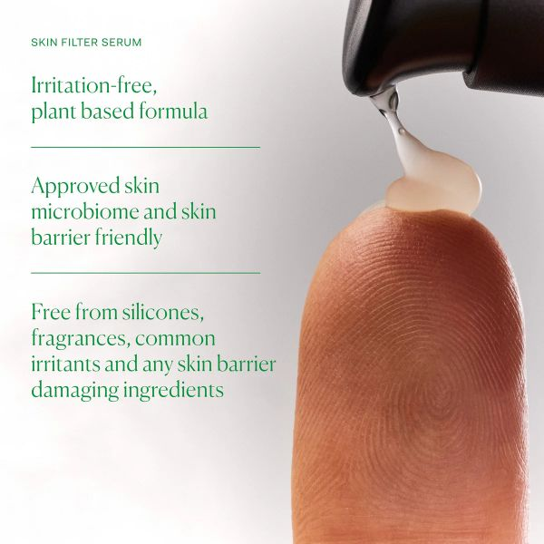
A revival of phyto and alt ingredients
Brands can capitalise by innovating with botanical ingredients known for their soothing properties, such as chamomile and Aloe vera, and leveraging new technologies to enhance their efficacy.
Transparent communication about the benefits and science behind these alternatives builds trust and credibility, while a focus on sustainable sourcing and eco-friendly practices appeals to environmentally conscious consumers. Additionally, offering personalised solutions for sensitive skin needs allows brands to meet the growing demand for kinder beauty options.
Consumers might be looking for gentler ingredient alternatives to counteract the stripping nature of strong actives, such as retinoids. With more consumers claiming to have sensitive skin or skin inflammation, new technologies can pave the way to botanical-inspired ingredients that don't compromise on efficacy.
The Nue Co. Skin Filter Serum uses a phyto-retinol alternative that is microbiome-friendly
Read on mintel.com
Notes:
This slide is from 2025 Beauty & Personal Care Trends (https://clients.mintel.com/content/trend/2025-beauty-personal-care-trends#workspace_SpacesStore_e7028e98-93e6-422c-9e60-de2733b18a69)
© 2024 Mintel Group Ltd. All Rights Reserved. Confidential to Mintel.

Slide 35
What's next?
Read on mintel.com
Notes:
This slide is from 2025 Beauty & Personal Care Trends (https://clients.mintel.com/content/trend/2025-beauty-personal-care-trends#workspace_SpacesStore_d76cecd9-25f6-4a94-bd65-aa512362104b)
© 2024 Mintel Group Ltd. All Rights Reserved. Confidential to Mintel.

Slide 36
The rise of eco-conscious beauty choices are driven by climate awareness
An increasing determination drives consumer preference to make sustainable choices in response to recent climate disasters.
nature-inspired biotech
purchase interest
eco determination
64%
66%
54%
of French consumers who research beauty ingredients would prefer natural ingredients grown in a lab over synthetic ones
of Japanese adults are interested in buying beauty products with environmental/eco-friendly claims
of US adults agree that recent climate disasters have made them more determined to make sustainable choices
Base: France: 809 internet users aged 16+ who research the ingredients used in the beauty/grooming products they buy; Japan, US: 2,000 internet users aged 18+ in each market
Source: Kantar Profiles/Mintel, June 2024, April 2024; Rakuten Insight/Mintel, February 2024
Read on mintel.com
Notes:
Source: Kantar Profiles/Mintel, June 2024, April 2024; Rakuten Insight/Mintel, February 2024
This slide is from 2025 Beauty & Personal Care Trends (https://clients.mintel.com/content/trend/2025-beauty-personal-care-trends#workspace_SpacesStore_698694a4-78c0-4bfe-9d1a-7d8c84f39f69)
© 2024 Mintel Group Ltd. All Rights Reserved. Confidential to Mintel.

Slide 37
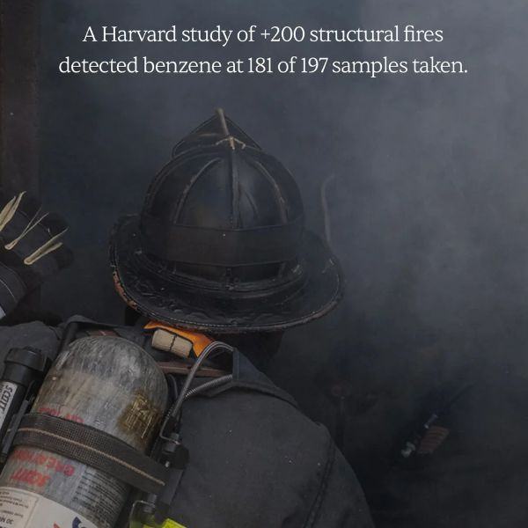
Embrace the future and redefine sustainable beauty through innovation
As consumer demand for natural, lab-grown ingredients and eco-friendly products grows, the Turning The Tide Trend propels brands to adopt sustainable practices.
By leveraging biopharming and ingredient upcycling, and forming innovative partnerships, brands can create zero-waste, circular-economy-aligned products.
To stand out in a competitive market, brands will integrate sustainability into their core identity, ensuring these efforts resonate with consumers.
For example, products like Peterson's Lab Moisturiser, designed for the extreme climate of Gansu province, will combine minimalism, regional adaptation and corporate social responsibility, supporting local economies while offering targeted solutions.
Broc Shot highlights the environmental safety risks firefighters face
Read on mintel.com
Notes:
This slide is from 2025 Beauty & Personal Care Trends (https://clients.mintel.com/content/trend/2025-beauty-personal-care-trends#workspace_SpacesStore_6cfc7f1a-bd81-4a46-831b-fe58dd9c3e23)
© 2024 Mintel Group Ltd. All Rights Reserved. Confidential to Mintel.

Slide 38


Frame sustainability as a benefit to make it an integral and effortless part of the consumer experience
Kirishima Shuzo, a major shochu manufacturer in Japan, announced a collaboration with Starbucks Japan to open a new facility in Miyazaki Prefecture in 2026. The facility will be powered entirely by biogas from shochu production waste, and its heating will use distillation waste heat.
Kao Corporation and Lion Corporation succeeded in creating the first products made partially with recycled refill packs to produce the same type of packaging as the original.
A new facility powered entirely by biogas from shochu production waste
Kao's Attack ZERO refill pack made with newly developed recycled material
Read on mintel.com
Notes:
This slide is from 2025 Beauty & Personal Care Trends (https://clients.mintel.com/content/trend/2025-beauty-personal-care-trends#workspace_SpacesStore_6d73e194-a23c-4f98-9ba8-de6e2441b78a)
© 2024 Mintel Group Ltd. All Rights Reserved. Confidential to Mintel.

Slide 39
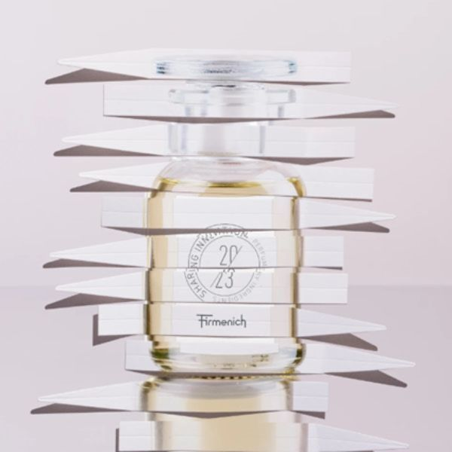
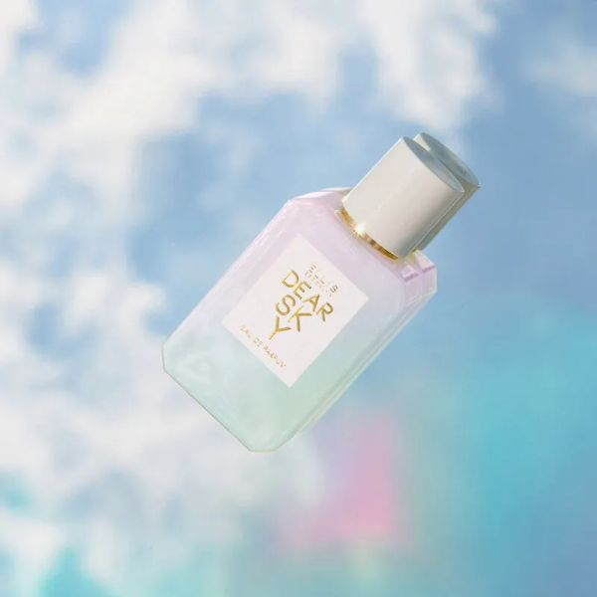
Fragrances pave the way for upcycled materials
New technologies from biopharming and combining technology with new agriculture techniques will revive ingredient upcycling opportunities. There will be opportunities to collaborate with food and drink brands to leverage new ingredients that are more sustainably sourced and focused on a zero-waste process.
Firmenich Sylvamber uses upcycled cedarwood from the furniture industry
Ellis Brooklyn Dear Sky uses seven upcycled ingredients
Read on mintel.com
Notes:
This slide is from 2025 Beauty & Personal Care Trends (https://clients.mintel.com/content/trend/2025-beauty-personal-care-trends#workspace_SpacesStore_2be7b7b7-06bb-438a-b8a8-b48f173ac41b)
© 2024 Mintel Group Ltd. All Rights Reserved. Confidential to Mintel.

Slide 40
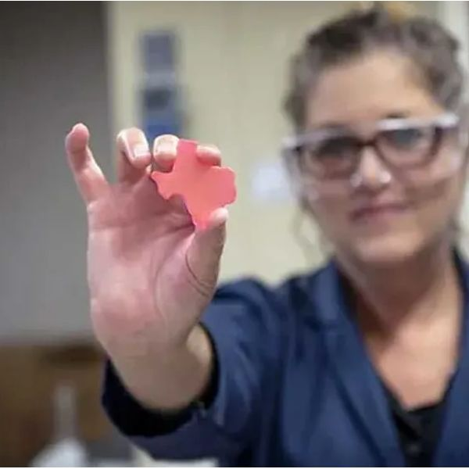
Sustainable innovations fuel the beauty revolution
The beauty industry is at the cusp of transformation as it embraces innovative solutions like Teysha Technologies' AggiePol and precision fermentation to drive the Turning The Tide Trend forward. AggiePol offers a biodegradable alternative to microplastics, addressing the urgent need for sustainable thickening and stabilising agents in cosmetics while reducing environmental impact.
Simultaneously, precision fermentation enables the production of specific ingredients in a controlled, waste-reducing manner, enhancing sustainability. By integrating these cutting-edge technologies, brands can create eco-friendly products that maintain efficacy and resonate with the growing segment of environmentally conscious consumers.
This dual approach not only provides a commercial edge but also sets new sustainability standards, positioning brands as leaders in the eco beauty movement.
Teysha Technologies launched AggiePol bioplastic derived from all-natural feedstocks
Read on mintel.com
Notes:
This slide is from 2025 Beauty & Personal Care Trends (https://clients.mintel.com/content/trend/2025-beauty-personal-care-trends#workspace_SpacesStore_7ee36b97-6b46-4f62-a32d-6f05eaac524b)
© 2024 Mintel Group Ltd. All Rights Reserved. Confidential to Mintel.

Slide 41
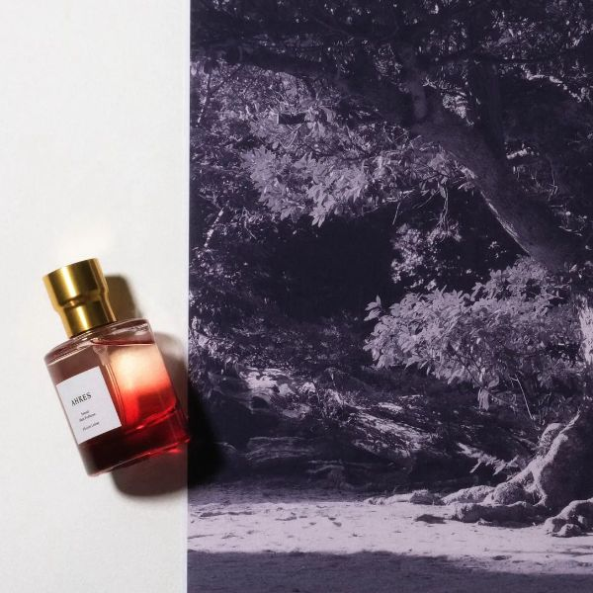
Groundbreaking sustainability initiatives will harmonise with the Earth's natural systems
Brands will explore solutions rooted in the soil, leveraging regenerative farming and sustainable fishing practices. For example, innovative ingredients like glycoproteins derived from lobsters will become more common, offering high-performance benefits while supporting marine conservation.
As precision fermentation and vertical farming become mainstream, brands will adopt these technologies to produce bio-synthetic ingredients with minimal environmental impact.
Brands will also invest in closed-loop recycling systems and advanced filtration to capture microplastics, aligning their entire operations with sustainable practices. Companies like FERMENSTATION, which turns unused resources into bioethanol, will inspire a new standard in circular economies, creating a future in which every aspect of beauty production, from sourcing to disposal, supports a healthier planet.
Ahres Sound Skin Perfume is formulated with FERMENSTATION's bioethanol
Read on mintel.com
Notes:
This slide is from 2025 Beauty & Personal Care Trends (https://clients.mintel.com/content/trend/2025-beauty-personal-care-trends#workspace_SpacesStore_4ba53239-9db9-481c-a583-7a4885e9b9d9)
© 2024 Mintel Group Ltd. All Rights Reserved. Confidential to Mintel.

Slide 42
What will happen in the future…
Read on mintel.com
Notes:
This slide is from 2025 Beauty & Personal Care Trends (https://clients.mintel.com/content/trend/2025-beauty-personal-care-trends#workspace_SpacesStore_b74e5dab-1534-42c2-b69d-1303fbc251c7)
© 2024 Mintel Group Ltd. All Rights Reserved. Confidential to Mintel.

Slide 43

A day in the life…
Read on mintel.com
Notes:
This slide is from 2025 Beauty & Personal Care Trends (https://clients.mintel.com/content/trend/2025-beauty-personal-care-trends#workspace_SpacesStore_ac366ac2-59a0-4eaa-8c1f-4065f66ef549)
© 2024 Mintel Group Ltd. All Rights Reserved. Confidential to Mintel.

Slide 44
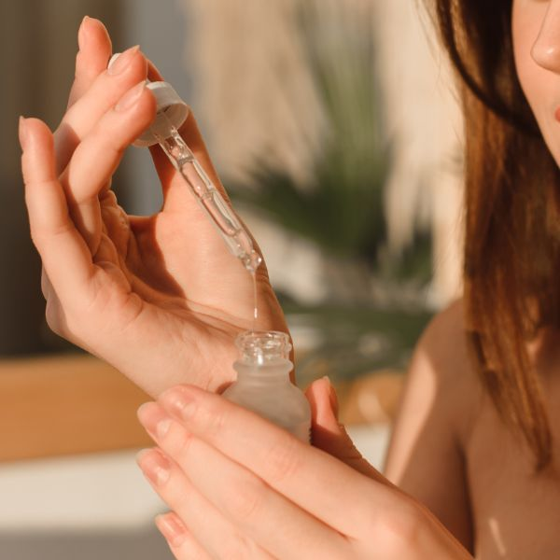
A day in the life…
As dawn breaks in the not-so-distant future, Sarah wakes up to the gentle hum of her eco-friendly smart home. She begins her day with a rejuvenating skincare routine, using products harvested from regenerative farms.
Her facial serum, enriched with glycoproteins sourced sustainably from lobsters, glides effortlessly over her skin, providing a marine-infused boost that also supports ocean conservation.
After breakfast, Sarah heads to work, her beauty bag filled with climate-adaptive products. Her moisturiser automatically adjusts its formula to protect against the day's weather forecast – balmy with a chance of UV spikes. Meanwhile, her deodorant responds intuitively to her body temperature, releasing odour-neutralising molecules when she needs them most.
Read on mintel.com
Notes:
This slide is from 2025 Beauty & Personal Care Trends (https://clients.mintel.com/content/trend/2025-beauty-personal-care-trends#workspace_SpacesStore_9b4cf9e1-6f00-445c-8dfe-a594590ec4e1)
© 2024 Mintel Group Ltd. All Rights Reserved. Confidential to Mintel.

Slide 45
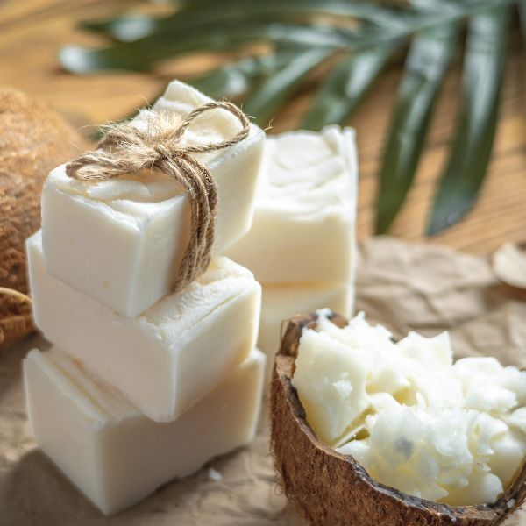
A day in the life…
During lunch, Sarah visits a personalised-beauty kiosk powered by AI and precision fermentation. Here, products are crafted on demand using bio-synthetic ingredients derived from sustainable sources – ensuring every product she uses is carbon negative and tailored specifically for her skin's needs.
As the day winds down, Sarah takes a moment to appreciate the closed-loop recycling system of her beauty products; for example, her shampoo bottles, made from biodegradable polymers, are designed to break down into harmless substances after disposal.
In Sarah's world, the Turning The Tide Trend seamlessly integrates into her daily life, transforming the beauty industry into a beacon of innovation and environmental stewardship.
Every product choice she makes not only enhances her beauty routine but also contributes to a healthier planet, harmonising modern living with nature's rhythms.
Read on mintel.com
Notes:
This slide is from 2025 Beauty & Personal Care Trends (https://clients.mintel.com/content/trend/2025-beauty-personal-care-trends#workspace_SpacesStore_9e838351-5603-4196-81d1-249b838c9da4)
© 2024 Mintel Group Ltd. All Rights Reserved. Confidential to Mintel.

Slide 46
THINK SLOW, MOVE FAST
Read on mintel.com
Notes:
This slide is from 2025 Beauty & Personal Care Trends (https://clients.mintel.com/content/trend/2025-beauty-personal-care-trends#workspace_SpacesStore_c3dcd827-1a78-4d04-9a03-48900e964457)
© 2024 Mintel Group Ltd. All Rights Reserved. Confidential to Mintel.

Slide 47
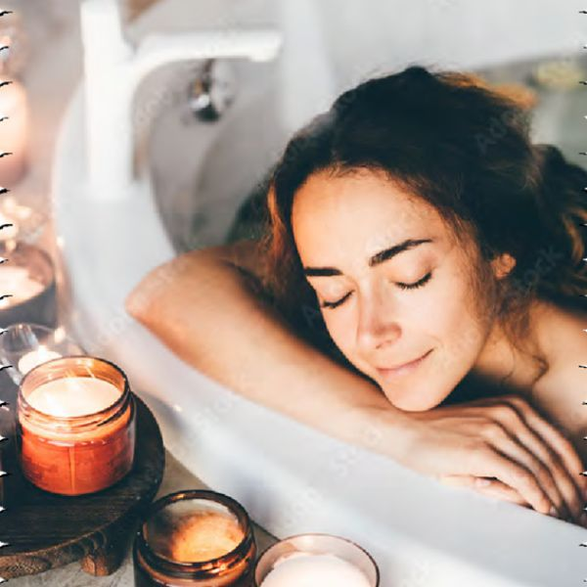
Move towards mindfulness and intentionality
The 'slow living' trend is urging a return to simple, authentic beauty products with minimal ingredients as consumers grow sceptical of overhyped products and complex routines.
This shift nudges brands to craft straightforward, effective offerings that resonate personally and evoke wellbeing through sensorial experiences, nostalgic scents or joyful packaging.
Amid low perceptions of innovation, aligning with slow living can lead to meaningful change. Instead of rapid, shallow releases, brands have a chance to innovate in harmony with slow living values, emphasising sustainability and authenticity.
This era challenges the beauty industry to rethink approaches, focusing on thoughtful engagement and individual wellbeing, alongside planetary health. As consumers reassess values, brands can lead with innovation that truly matters.
Read on mintel.com
Notes:
This slide is from 2025 Beauty & Personal Care Trends (https://clients.mintel.com/content/trend/2025-beauty-personal-care-trends#workspace_SpacesStore_35afe17e-1430-405c-a55b-f2d25b05a5e0)
© 2024 Mintel Group Ltd. All Rights Reserved. Confidential to Mintel.

Slide 48
What's now?
Read on mintel.com
Notes:
This slide is from 2025 Beauty & Personal Care Trends (https://clients.mintel.com/content/trend/2025-beauty-personal-care-trends#workspace_SpacesStore_2812bacb-0ed2-4bca-a047-578c6fba9d45)
© 2024 Mintel Group Ltd. All Rights Reserved. Confidential to Mintel.

Slide 49
Mental wellness and nostalgia are at the heart of savvy consumer choices
Adults prioritise mental health and nostalgia in their wellbeing, while also valuing thoughtful decision making when purchasing products.
power of the mind
nostalgia comfort
value mindfulness
89%
65%
74%
of Canadian adults* agree that maintaining good mental health is key to overall wellbeing
of Australian adults* enjoy products that remind them of the past
of French adults* think it's worth taking the time to compare products to find the best deal
Base: Canada, Australia: 1,000 internet users aged 18+ in each market; France: 1,000 internet users aged 16+
Source: Kantar Profiles/Mintel, March 2024
Read on mintel.com
Notes:
Source: Kantar Profiles/Mintel, March 2024
This slide is from 2025 Beauty & Personal Care Trends (https://clients.mintel.com/content/trend/2025-beauty-personal-care-trends#workspace_SpacesStore_25d48c6d-4929-4011-870d-8d986c2222ab)
© 2024 Mintel Group Ltd. All Rights Reserved. Confidential to Mintel.

Slide 50
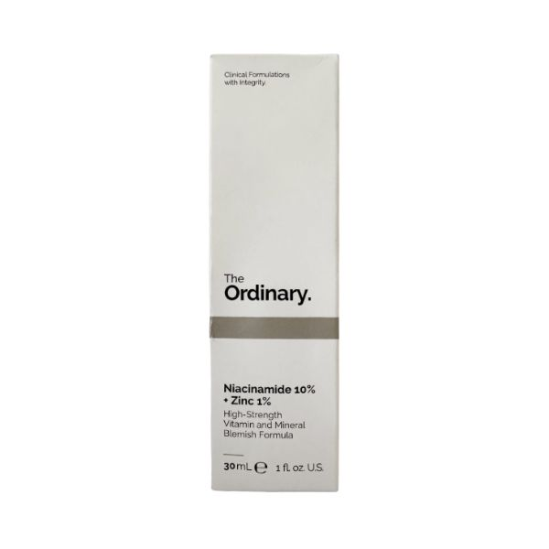
Brands can thrive by embracing simplicity
As the beauty industry navigates a period of slowed innovation, brands have a unique opportunity to align with the Think Slow, Move Fast Trend and meet evolving consumer expectations.
To seize this opportunity, beauty brands should prioritise transparency and ingredient safety, crafting products that are not only effective but also simple and straightforward.
By focusing on reformulations and range extensions that highlight natural ingredients and clear benefits, brands can resonate with consumers who are increasingly mindful about their purchases. This approach not only builds trust but also positions the brand as a thoughtful leader in a crowded market, catering to consumers who appreciate quality over quantity.
The Ordinary Niacinamide 10% + Zinc 1% emphasises ingredient safety and transparency
Read on mintel.com
Notes:
This slide is from 2025 Beauty & Personal Care Trends (https://clients.mintel.com/content/trend/2025-beauty-personal-care-trends#workspace_SpacesStore_8f1df1f4-60cb-4586-8cc5-6550aa205d5e)
© 2024 Mintel Group Ltd. All Rights Reserved. Confidential to Mintel.

Slide 51

Harness AI for personalised and purposeful consumer experiences
Beauty brands can leverage AI and digital platforms to deepen consumer engagement and offer personalised experiences.
By using data-driven insights, brands can tailor their offerings to individual needs, fostering a sense of connection and loyalty. This strategy is particularly effective in encouraging deliberate purchasing, as it aligns with the consumer's desire for products that reflect their personal values and lifestyle choices.
By adopting these recommendations, beauty brands can embrace the Think Slow, Move Fast mindset, creating meaningful interactions that satisfy the modern consumer's quest for authenticity and mindful consumption.
Sephora's Virtual Artist complements the trend by enabling informed, personalised and sustainable beauty choices through virtual try-ons, aligning technology with mindful consumption.
Sephora's Virtual Artist can actually emphasise mindfulness and deliberate consumption
Read on mintel.com
Notes:
This slide is from 2025 Beauty & Personal Care Trends (https://clients.mintel.com/content/trend/2025-beauty-personal-care-trends#workspace_SpacesStore_aa45b5f3-2c8f-47dc-9c63-68361465d944)
© 2024 Mintel Group Ltd. All Rights Reserved. Confidential to Mintel.

Slide 52
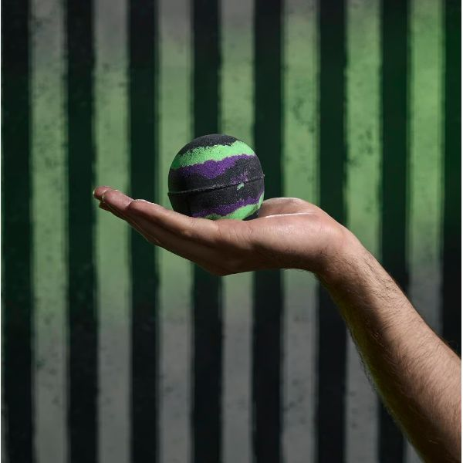
Develop products that support mental wellness, such as calming or aromatherapeutic solutions
The growing emphasis on mental health, nostalgia and thoughtful purchasing is propelling the Trend, encouraging consumers to prioritise quality over quantity.
For brands, crafting transparent, value-driven campaigns can do more than just attract consumers. They can simplify the decision-making process, reducing the stress of choosing the right product. By clearly communicating product quality and sustainability, these campaigns help consumers make informed choices with confidence. Aligning with these values fosters deeper connections and enhances loyalty among discerning consumers who seek meaningful, mindful engagement.
Lush's Afterlife Bath Bomb focuses on creating a sensory experience with vibrant colours and popping candy, offering a nostalgic and playful bath time – it promotes relaxation and mental wellness through a fun, immersive experience, encouraging a moment for the self.
The Afterlife Bath Bomb is part of Lush's Beetlejuice Beetlejuice collaboration
Read on mintel.com
Notes:
This slide is from 2025 Beauty & Personal Care Trends (https://clients.mintel.com/content/trend/2025-beauty-personal-care-trends#workspace_SpacesStore_fb2ee36c-ecbb-4587-9130-0b23c9d4f39f)
© 2024 Mintel Group Ltd. All Rights Reserved. Confidential to Mintel.

Slide 53
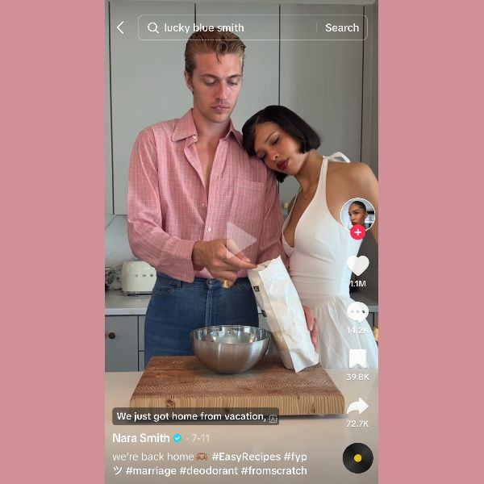

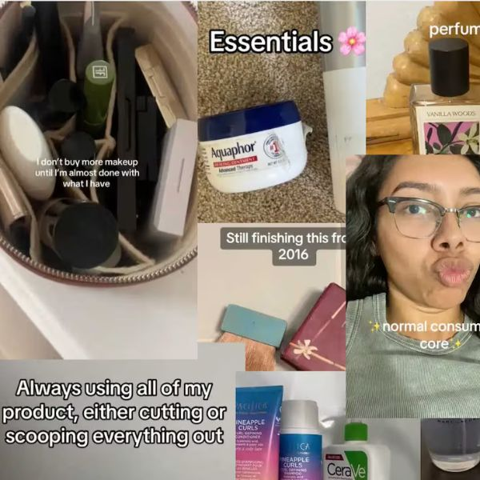
Social media glamorises the simple life
There is a growing desire for authenticity, simplicity and a more thoughtful approach to life, echoing the core principles of the Think Slow, Move Fast Trend.
Trad wives
'Trad wives' (short for traditional) like Hannah Neeleman and Nara Smith (shown here making deodorant with her husband) have amassed significant followings over the past year.
Lazy health trend
China's Gen Z embraces 'lazy health' by integrating low-effort wellness practices and community connections into their fast-paced digital lifestyles.
Underconsumption
People are embracing minimalism and rejecting excessive consumerism, highlighting the importance of quality over quantity. Cater to people seeking meaningful products and experiences, rather than just promoting constant consumption.
Read on mintel.com
Notes:
This slide is from 2025 Beauty & Personal Care Trends (https://clients.mintel.com/content/trend/2025-beauty-personal-care-trends#workspace_SpacesStore_6d7acfa1-e977-46ae-beaa-c60a8e84a656)
© 2024 Mintel Group Ltd. All Rights Reserved. Confidential to Mintel.

Slide 54
What's next?
Read on mintel.com
Notes:
This slide is from 2025 Beauty & Personal Care Trends (https://clients.mintel.com/content/trend/2025-beauty-personal-care-trends#workspace_SpacesStore_6bfd27f5-4bc0-4865-b5f1-7ae7709816d1)
© 2024 Mintel Group Ltd. All Rights Reserved. Confidential to Mintel.

Slide 55

Consumers reflect a holistic and proactive attitude towards personal wellbeing
People increasingly value confidence-boosting beauty routines, prioritise everyday indulgences and adopt preventative skincare approaches.
feeling good
everyday pleasures
protection priority
86%
70%
76%
of Brazilian adults* agree that looking good makes them feel more confident
of German adults* prioritise indulging in everyday pleasures
of Chinese adults* take a preventative approach to beauty/skincare
* taken from Mintel's Global Consumer
Base: Brazil, Germany: 1,000 internet users aged 16+ in each market; China: 1,000 internet users aged 18+
Source: Kantar Profiles/Mintel, March 2024
Read on mintel.com
Notes:
* taken from Mintel's Global Consumer
Source: Kantar Profiles/Mintel, March 2024
This slide is from 2025 Beauty & Personal Care Trends (https://clients.mintel.com/content/trend/2025-beauty-personal-care-trends#workspace_SpacesStore_247fe573-2a40-4cc6-8c66-377b8f890ee9)
© 2024 Mintel Group Ltd. All Rights Reserved. Confidential to Mintel.

Slide 56

Strategies for comfort, wellness and credibility lead the slow-beauty revolution
Beauty brands should focus on enhancing comfort and emotional wellbeing by crafting products with soothing scents and textures that invoke nostalgia.
By aligning innovation cycles with sustainable consumption, they can create effective products for budget-conscious consumers. Prioritising wellness integration, brands should emphasise longevity and psychodermatology, using scientifically proven ingredients and holistic approaches to address wellbeing.
Exploring neuroscience can lead to tranquil beauty experiences. To build credibility, brands must demonstrate product efficacy through scientific testing and innovative ingredients, allowing consumers to enjoy slow living benefits while staying engaged with a fast-paced lifestyle.
Read on mintel.com
Notes:
This slide is from 2025 Beauty & Personal Care Trends (https://clients.mintel.com/content/trend/2025-beauty-personal-care-trends#workspace_SpacesStore_edb3f0aa-f98e-47b3-a7eb-c32db7d63bf0)
© 2024 Mintel Group Ltd. All Rights Reserved. Confidential to Mintel.

Slide 57
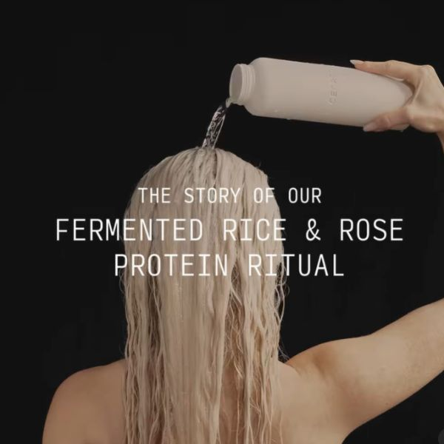
Reinvent traditional ingredients that offer natural benefits to appeal to consumers seeking simplicity
Brands can enhance their market position by adopting sustainable practices like upcycling, which builds trust and encourages mindful consumption. By showcasing product lifecycles, brands can attract eco-conscious consumers and lead in sustainable beauty, tapping into this expanding market.
To maximise these opportunities, brands should innovate by updating traditional practices, such as using fermented rice, to create convenient, culturally rich products that appeal to those interested in efficacy.
Demonstrating credibility through scientific testing and transparent ingredient sourcing can meet consumer demands and boost their confidence. By communicating these benefits and educating consumers, brands can gain a competitive edge in the slow-beauty movement, offering products that are effective and support a mindful lifestyle.
Cécred's Fermented Rice & Rose Protein Ritual is inspired by ancient practices
Read on mintel.com
Notes:
This slide is from 2025 Beauty & Personal Care Trends (https://clients.mintel.com/content/trend/2025-beauty-personal-care-trends#workspace_SpacesStore_66324ebf-1e4a-48f0-a729-fa56a8e808fc)
© 2024 Mintel Group Ltd. All Rights Reserved. Confidential to Mintel.

Slide 58
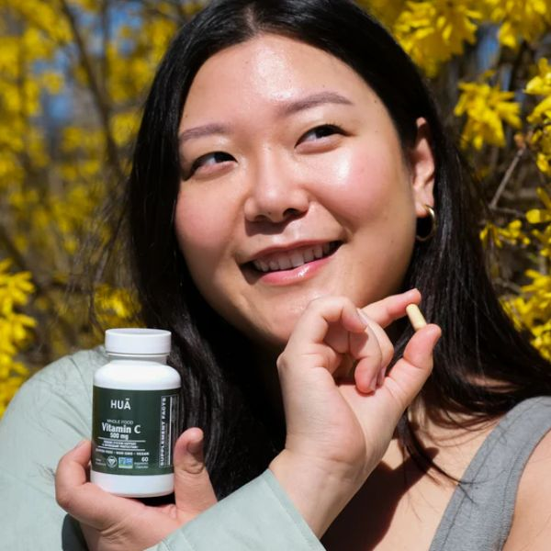
Set the pace for natural and mindful wellbeing
HUA Wellness highlights what it calls 'nature deficient disorder' – which is the idea that humans are spending less time in nature, making people more stressed and anxious.
Its approach focuses on reconnecting people with nature through premium products and advocating for green spaces, aligning with the slow living ethos of mindfulness and sustainability.
Brands should focus on creating products that emphasise natural ingredients and sustainability. They can innovate by developing solutions that address unmet needs with effective, clinically studied ingredients.
Additionally, brands should highlight their commitment to transparency and safety, ensuring consumers are informed about what they are using. By fostering a connection to nature and promoting a mindful lifestyle, brands can attract consumers seeking a slower, more intentional approach to wellness.
HUA Wellness emphasises a deep connection to nature and the use of high-quality, natural ingredients
Read on mintel.com
Notes:
This slide is from 2025 Beauty & Personal Care Trends (https://clients.mintel.com/content/trend/2025-beauty-personal-care-trends#workspace_SpacesStore_d357ccd0-fc49-4f17-9115-328a570ebf86)
© 2024 Mintel Group Ltd. All Rights Reserved. Confidential to Mintel.

Slide 59
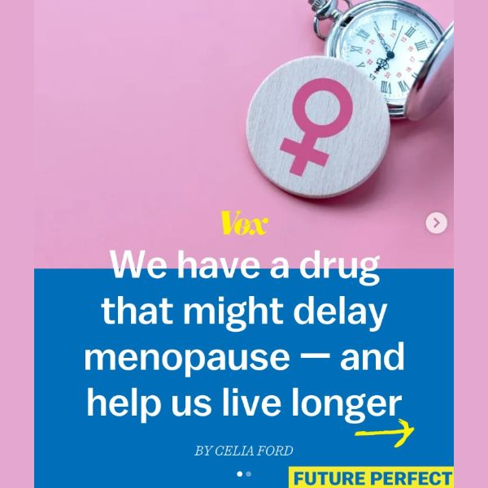
Focus on a gradual, scientifically supported approach to ageing and wellness
A focus on longevity emphasises a more thoughtful and deliberate strategy, contrasting with the allure of the quick fixes and miraculous solutions often seen in the wellness industry.
For brands looking to capitalise on this trend, the key lies in developing health solutions that are firmly rooted in science and prioritise long-term benefits.
Emphasising sustainable practices in product development not only resonates with eco-conscious consumers but also reinforces a commitment to long-term wellness. Building consumer trust through transparent communication and educational initiatives will empower customers to make informed decisions, ultimately fostering a loyal following and positioning brands as leaders in the evolving beauty landscape.
Longevity research and anti-ageing science focus on a gradual, scientifically supported approach
Source: Instagram/votdotcom
Read on mintel.com
Notes:
Source: Instagram/votdotcom [1]
[1] https://www.instagram.com/p/C-k2BsrAx3s/
This slide is from 2025 Beauty & Personal Care Trends (https://clients.mintel.com/content/trend/2025-beauty-personal-care-trends#workspace_SpacesStore_a2f2b989-0328-4b16-99f5-3b57b7dd4ed7)
© 2024 Mintel Group Ltd. All Rights Reserved. Confidential to Mintel.

Slide 60
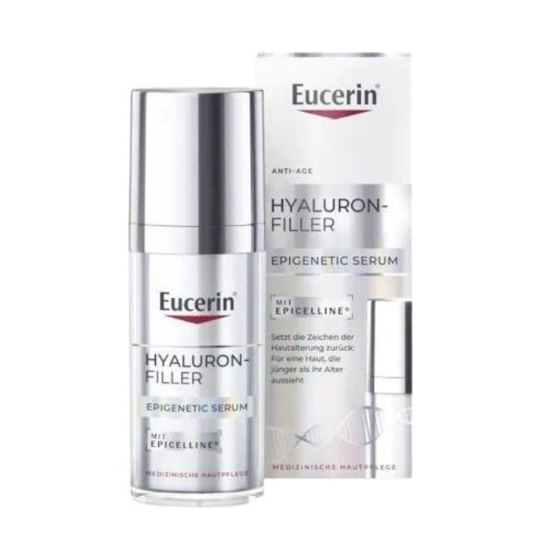
Redefine slow beauty with biohacking
Brands should prioritise developing products that deliver enduring benefits through robust scientific research. Collaboration with research institutions can ensure that evidence validates their offerings.
Transparency about the scientific processes and efficacy of ingredients helps build consumer trust. Additionally, educating consumers about the science behind the products can empower them to make informed decisions and foster brand loyalty.
Beiersdorf's Eucerin Hyaluron-Filler Epigenetic Serum exemplifies this trend through its focus on the gradual rejuvenation of skin using scientifically backed methods. By reactivating 'youth genes' and counteracting DNA methylation, the serum offers a thoughtful, long-term approach to anti-ageing, aligning with the slow living ethos that values sustainability and mindfulness over instant results.
Eucerin Epigenetic Serum focuses on gradual skin rejuvenation
Read on mintel.com
Notes:
This slide is from 2025 Beauty & Personal Care Trends (https://clients.mintel.com/content/trend/2025-beauty-personal-care-trends#workspace_SpacesStore_627af831-8eb2-4a86-8af9-5977bebc25e8)
© 2024 Mintel Group Ltd. All Rights Reserved. Confidential to Mintel.

Slide 61
What will happen in the future…
Read on mintel.com
Notes:
This slide is from 2025 Beauty & Personal Care Trends (https://clients.mintel.com/content/trend/2025-beauty-personal-care-trends#workspace_SpacesStore_d6ee97cd-d0aa-4468-bbf5-1f7b5461f45e)
© 2024 Mintel Group Ltd. All Rights Reserved. Confidential to Mintel.

Slide 62

A day in the life…
Read on mintel.com
Notes:
This slide is from 2025 Beauty & Personal Care Trends (https://clients.mintel.com/content/trend/2025-beauty-personal-care-trends#workspace_SpacesStore_6d90cd10-22b6-4012-b07d-7140f7c1e99b)
© 2024 Mintel Group Ltd. All Rights Reserved. Confidential to Mintel.

Slide 63
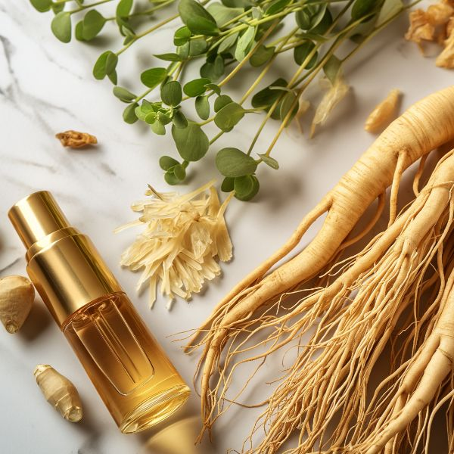
A day in the life…
In a future defined by slow living, May's day begins with the gentle light of dawn filtering through their windows. They rise to the simplicity of a routine that harmonises with nature's rhythm. In the quiet of their kitchen, May crafts a bespoke beauty blend from fresh garden-picked herbs and essential oils, celebrating the purity and minimalism that have come to epitomise modern beauty.
After enjoying a peaceful breakfast, May engages in a rejuvenating DIY beauty session, applying handmade concoctions that enhance their skin's natural glow, allowing them to connect deeply with the essence of simplicity.
Mid-morning, May participates in cryo-preservation – an innovative service that aligns their beauty desires with long-term health goals. This experience offers a profound sense of renewal, as May's beauty regimen is seamlessly integrated into their journey towards longevity and mental wellbeing.
Read on mintel.com
Notes:
This slide is from 2025 Beauty & Personal Care Trends (https://clients.mintel.com/content/trend/2025-beauty-personal-care-trends#workspace_SpacesStore_bba460cc-0168-4154-bffe-82ecc2cd41fd)
© 2024 Mintel Group Ltd. All Rights Reserved. Confidential to Mintel.

Slide 64

A day in the life…
The afternoon finds May retreating to a serene 'disconnect-to-reconnect' sanctuary, nestled within nature's embrace. Here, amid the rustling leaves and soothing streams, they share meaningful moments with fellow participants, all while leaving behind the relentless clamour of digital life.
As evening approaches, May indulges in a beauty ritual that marries past wisdom with modern innovations. They apply a luxurious cream, enriched with ancient black rice and advanced yeast strains, feeling grateful for this fusion of tradition and technology. They are reminded that beauty is not merely skin deep but rather a holistic and mindful experience.
As the day ends, May reflects on how their beauty routine, once a series of tasks, has transformed into a meaningful journey, embracing the balance between simplicity and innovation and fostering a deeper connection with their authentic self.
Read on mintel.com
Notes:
This slide is from 2025 Beauty & Personal Care Trends (https://clients.mintel.com/content/trend/2025-beauty-personal-care-trends#workspace_SpacesStore_5227c8e4-7a08-43ee-be6c-9216266e7e82)
© 2024 Mintel Group Ltd. All Rights Reserved. Confidential to Mintel.

Slide 65
Key takeaways
(MY) KNOWLEDGE IS POWER
Empowered consumers are driving demand for transparency and authenticity, seeking beauty products that align with their personal values and unique identities. Brands should leverage social media insights and focus on hyper-personalisation to capture this market.
TURNING THE TIDE
Sustainability is now a baseline expectation, with consumers favouring brands that integrate eco-friendly practices and collaborate with green initiatives, but not at the cost of product efficacy. Embrace science-driven expertise to lead in environmental stewardship and appeal to eco-conscious buyers.
THINK SLOW, MOVE FAST
The slow-beauty movement calls for simple, effective products that prioritise mental wellness and nostalgia. Brands should focus on transparency, ingredient safety, and creating products that enhance emotional wellbeing through soothing scents and textures.
Read on mintel.com
Notes:
This slide is from 2025 Beauty & Personal Care Trends (https://clients.mintel.com/content/trend/2025-beauty-personal-care-trends#workspace_SpacesStore_a94dbc78-343c-466b-96ab-c569368f59b9)
© 2024 Mintel Group Ltd. All Rights Reserved. Confidential to Mintel.

Slide 66
Andrew McDougall
Global Beauty & Personal Care Analyst
amcdougall@mintel.com

