Slide 1
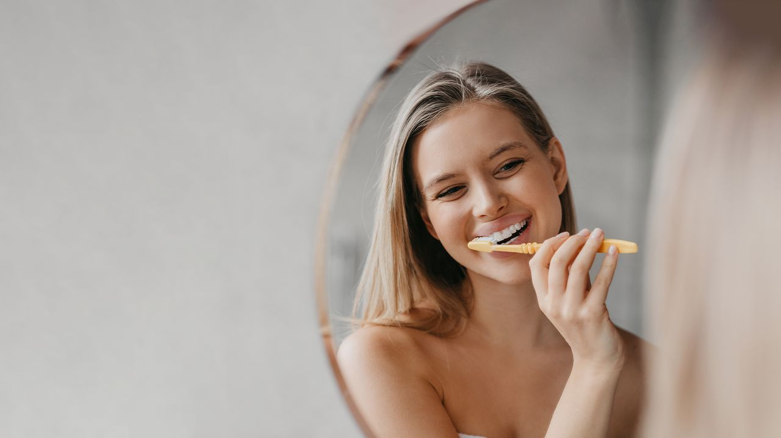

A year of innovation in oral care, 2024
Brands are catering to consumers' evolving needs and knowledge of oral health with products aiming to meet interest in the oral microbiome and expert dental care.
Georgia Stafford
Beauty & Personal Care Analyst
August 2024
Read on mintel.com
Notes:
This slide is from A year of innovation in oral care, 2024 (https://clients.mintel.com/content/report/a-year-of-innovation-in-oral-care-2024#workspace_SpacesStore_2a84d081-ae8d-4993-9064-97d411b78312)
© 2024 Mintel Group Ltd. All Rights Reserved. Confidential to Mintel.

Slide 2
Table Of Contents
1
EUROPE, MIDDLE EAST & AFRICA (EMEA)
2
ASIA PACIFIC (APAC)
3
THE AMERICAS

Slide 3
What we have seen
EMEA: relaunches and natural ingredients dominate
The natural ingredient trend is not fading, but there are opportunities for brands to differentiate by taking inspiration from Ayurvedic practices.
Europe also has been facing a decline in product launches, prompting a need for innovation that caters to consumer demand for novelty.
APAC: a spotlight on actives and longevity
Consumer understanding of the impact of the oral microbiome on overall health and wellbeing has prompted interest in oral care products containing pre- and probiotic ingredients.
Brands in Asia are also catering to consumers' desire to maximise the impact of their oral care routines through innovation in long-lasting claims.
Americas: premiumisation and scepticism collide
The premiumisation of oral care is underway as North Americans prioritise their oral health and are willing to invest in expensive products to avoid even costlier professional dental care.
To justify price, brands must prove value beyond typical claims and can partner with dentists for credibility.
Read on mintel.com
Notes:
This slide is from A year of innovation in oral care, 2024 (https://clients.mintel.com/content/report/a-year-of-innovation-in-oral-care-2024#workspace_SpacesStore_ec137e2d-b0f4-4406-bf6d-2ef91d4240ea)
© 2024 Mintel Group Ltd. All Rights Reserved. Confidential to Mintel.

Slide 4
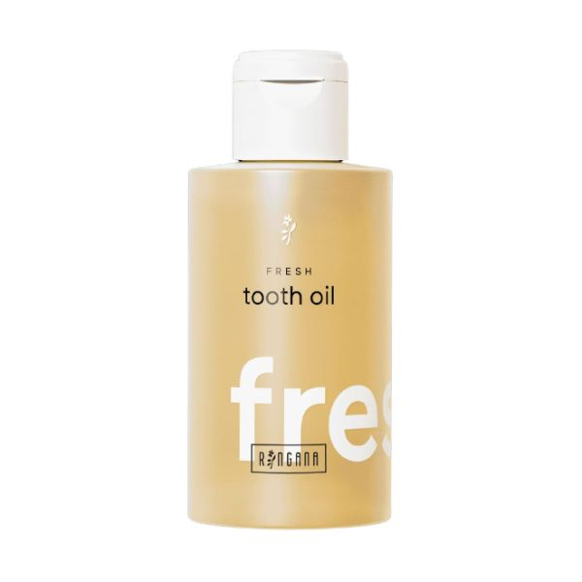
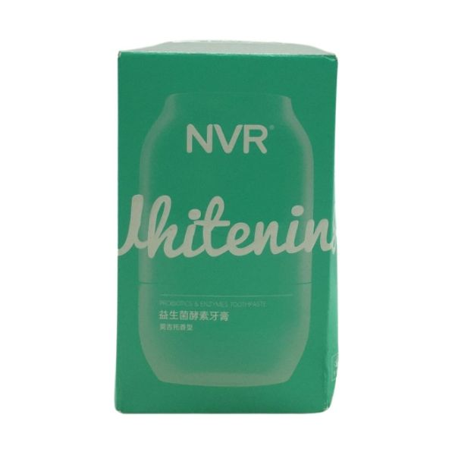
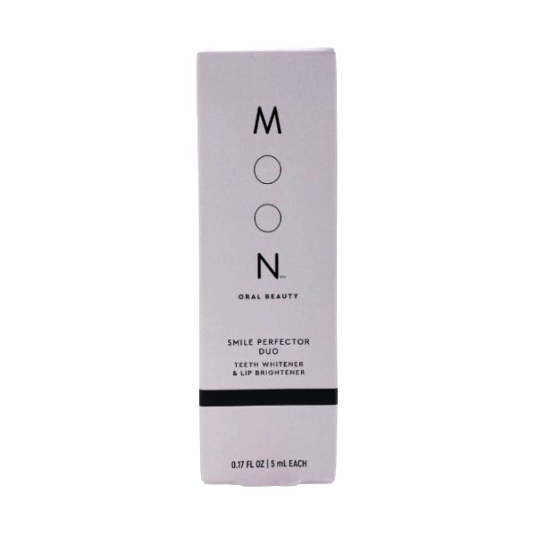
Our pick of the most innovative launches in this review
Natural oils
Ringana Fresh Tooth Oil embraces oil pulling (swishing oil around the mouth) with a formula containing natural ingredients (such as manuka oil, bisabolol and turmeric extract) to promote wound healing, combat inflammation and fight bacteria.
Tooth tech
NVR Probiotics & Enzymes Whitening Toothpaste contains probiotics to balance the oral microbiome and freshen breath. The toothpaste uses micro-capsule technology to ensure ingredients remain effective.
Beauty meets oral care
Moon Teeth Whitener & Lip Brightener blurs beauty with oral care. The dual-ended teeth whitener/lip gloss incorporates an antioxidant blend to gently whiten teeth and uses vitamin E to moisturise lips.
Read on mintel.com
Notes:
This slide is from A year of innovation in oral care, 2024 (https://clients.mintel.com/content/report/a-year-of-innovation-in-oral-care-2024#workspace_SpacesStore_2316343b-1af9-46a1-b199-a29a0b572021)
© 2024 Mintel Group Ltd. All Rights Reserved. Confidential to Mintel.

Slide 5
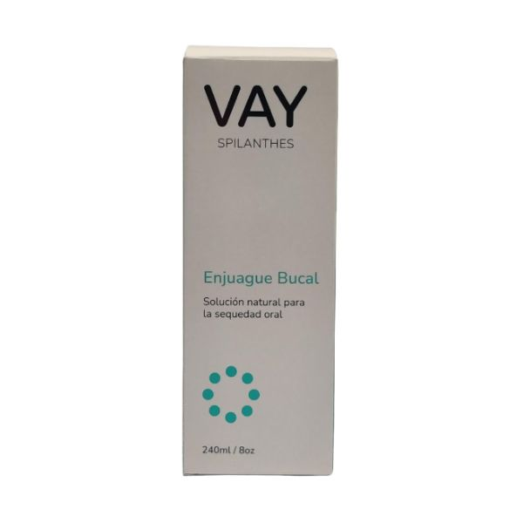
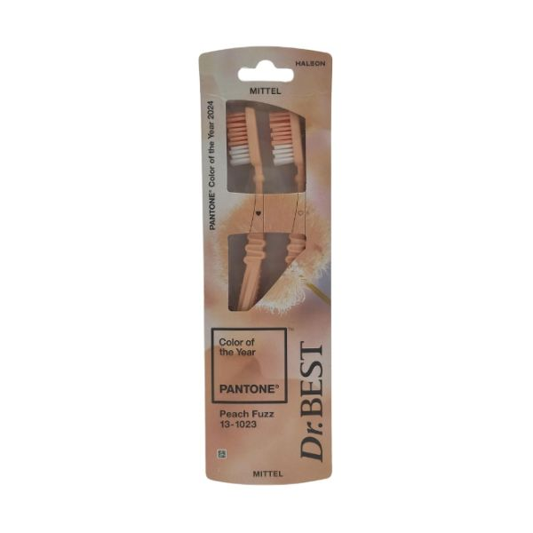
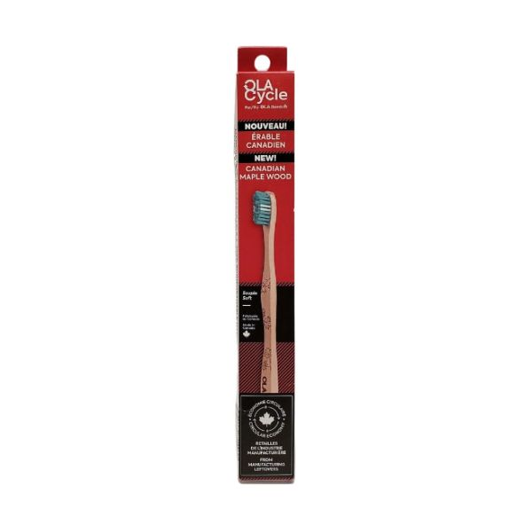
Other innovative launches
A niche ingredient
Vay Spilanthes Mouthwash is one of just four global oral care launches in the year to July 2024 to contain Spilathes acmella, an Amazonian flower thought to help with dry mouth.
Targets design-conscious consumers
Mittel Doctor Best Medium Toothbrush is made in collaboration with Pantone to feature its 2024 colour of the year, Peach Fuzz, for design-conscious oral care users.
Localisation
Ola Cycle by Ola Bamboo Soft Canadian Maple Wood Toothbrush is the first toothbrush made entirely from Canadian manufacturing leftovers. It also features a biodegradable handle.
Read on mintel.com
Notes:
This slide is from A year of innovation in oral care, 2024 (https://clients.mintel.com/content/report/a-year-of-innovation-in-oral-care-2024#workspace_SpacesStore_32a300cb-f8fd-49f2-8e31-2e0e00868559)
© 2024 Mintel Group Ltd. All Rights Reserved. Confidential to Mintel.

Slide 6

Europe, Middle East & Africa (EMEA)
Read on mintel.com
Notes:
This slide is from A year of innovation in oral care, 2024 (https://clients.mintel.com/content/report/a-year-of-innovation-in-oral-care-2024#workspace_SpacesStore_32394c13-879c-4d21-a71c-d8b93339d06f)
© 2024 Mintel Group Ltd. All Rights Reserved. Confidential to Mintel.

Slide 7
Europe: innovation is necessary
Read on mintel.com
Notes:
This slide is from A year of innovation in oral care, 2024 (https://clients.mintel.com/content/report/a-year-of-innovation-in-oral-care-2024#workspace_SpacesStore_6e0466d3-6d7d-4e72-bb5d-841b97704696)
© 2024 Mintel Group Ltd. All Rights Reserved. Confidential to Mintel.

Slide 8
Changing dynamics necessitate innovation
New product launches capture attention and consumer data corroborates the interest in newness, but the category is not aligning with this demand as brands have focused on cost-saving relaunches.
However, it is more important than ever to develop entirely new products. AI has levelled the playing field between large and small brands because algorithms can contribute to product innovation and help create marketing campaigns. The advent of AI also allows the NPD cycle to be shorter as it can quickly make sense of a vast amount of data.
The change in how NPD can be conducted proves that both large and small brands need to stay competitive and differentiate with innovation that appeals to the consumer interest in newness.
Brands can learn from other BPC categories (namely facial skincare) for format inspiration and leverage AI to find novel ingredients with oral care benefits.
Trying new things
30%
of Finnish adults* bought a new beauty/grooming product they had not tried before in the three months to March 2024
* taken from Mintel's Global Consumer
Base: Finland: 1,000 internet users aged 16+
Source: Kantar Profiles/Mintel, March 2024
Read on mintel.com
Notes:
* taken from Mintel's Global Consumer
Source: Kantar Profiles/Mintel, March 2024
This slide is from A year of innovation in oral care, 2024 (https://clients.mintel.com/content/report/a-year-of-innovation-in-oral-care-2024#workspace_SpacesStore_6578f22c-b7e6-4015-aadc-7647adbed2ef)
© 2024 Mintel Group Ltd. All Rights Reserved. Confidential to Mintel.

Slide 9
A need for newness
New product launches have been becoming less common in the European oral care category as brands have favoured relaunches and repackaging.
This could make it easy for genuine innovation (including format, claim or ingredient innovation) to capture consumer attention.
Newer brands in the category can establish credibility with ingredient transparency or dentist-approved claims.
Source: Mintel GNPD, August 2019-July 2024
Read on mintel.com
Notes:
Source: Mintel GNPD, August 2019-July 2024 [1]
[1] https://www.gnpd.com/sinatra/shared_link/405adabd-b88c-4293-8e95-a247c163685a
This slide is from A year of innovation in oral care, 2024 (https://clients.mintel.com/content/report/a-year-of-innovation-in-oral-care-2024#workspace_SpacesStore_304019ba-7431-42db-b6b7-0761c9ea4dc0)
© 2024 Mintel Group Ltd. All Rights Reserved. Confidential to Mintel.

Slide 10
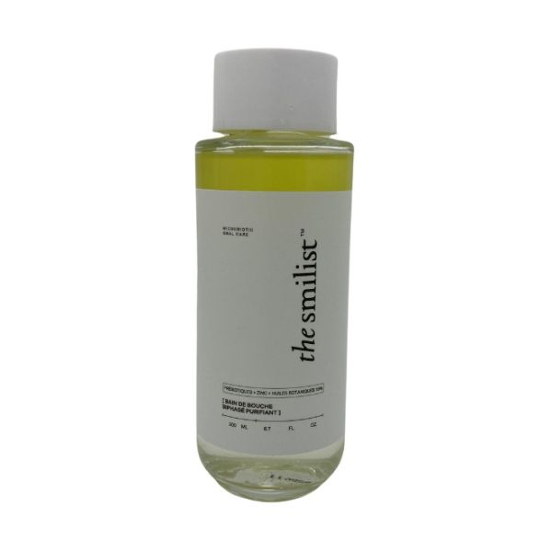
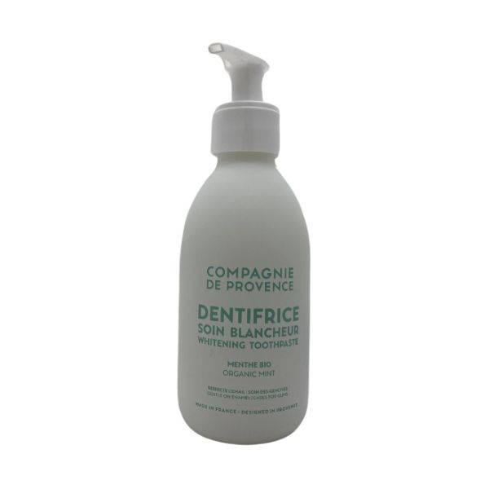
Novelty can attract consumer attention
Brands are disrupting the European oral care category with novel packaging and product formats to capture consumer attention.
Natural oils
Ringana Fresh Tooth Oil embraces oil pulling with a formula containing natural ingredients (such as manuka oil, bisabolol and turmeric extract) to promote wound healing, combat inflammation and fight bacteria.
Dual-phase formula
The Smilist Microbiotic Mouthwash features a dual-phased formula – more often seen in the facial skincare category. The product contains vitamins, prebiotics and minerals to neutralise bad breath and improve oral health.
Easy to refill
Compagnie de Provence Whitening Toothpaste comes in a refillable glass bottle, and the packaging focuses on ingredient transparency, detailing the benefits of fluoride, silica and green tea extract, among others.
Read on mintel.com
Notes:
This slide is from A year of innovation in oral care, 2024 (https://clients.mintel.com/content/report/a-year-of-innovation-in-oral-care-2024#workspace_SpacesStore_f28fe1bd-434b-4c19-b9f6-cb5dff516ccc)
© 2024 Mintel Group Ltd. All Rights Reserved. Confidential to Mintel.

Slide 11
Europe: next-gen naturals
Read on mintel.com
Notes:
This slide is from A year of innovation in oral care, 2024 (https://clients.mintel.com/content/report/a-year-of-innovation-in-oral-care-2024#workspace_SpacesStore_31b9cc21-45ee-4871-859d-0cb473ac05f6)
© 2024 Mintel Group Ltd. All Rights Reserved. Confidential to Mintel.

Slide 12
Differentiate with Ayurvedic ingredients
Consumers are concerned about the ingredients in oral care products, creating opportunities for brands using natural ingredients to allay consumer concerns. However, as botanical claims are common in the oral care category, brands can differentiate with Ayurveda-inspired ingredients.
Ayurveda is a traditional, holistic system of medicine that originated in India thousands of years ago that includes herbal remedies and natural ingredients. The use of Ayurvedic ingredients and traditions is becoming increasingly common in BPC, with brands (including Kama and Shanti) centring Ayurveda in their formulations and brand stories.
The Ayurvedic practice of tongue scraping is already a growing trend, according to Google Trends, which corroborates the consumer appetite for alternative approaches to oral health.
chemical concern
29%
of UK adults who use traditional toothpaste/gel worry about the chemicals in these products
Base: UK: 1,714 internet users aged who have used traditional toothpaste/gel in the last three months
Source: Kantar Profiles/Mintel, April 2024
Read on mintel.com
Notes:
Source: Kantar Profiles/Mintel, April 2024
This slide is from A year of innovation in oral care, 2024 (https://clients.mintel.com/content/report/a-year-of-innovation-in-oral-care-2024#workspace_SpacesStore_21c1d50d-c97f-4fba-a45b-7254428f6473)
© 2024 Mintel Group Ltd. All Rights Reserved. Confidential to Mintel.

Slide 13
Ayurvedic claims are niche, but growing
While still a niche trend, there has been some growth in European oral care launches referencing Ayurveda as brands have sought to meet the consumer appetite for functional natural ingredients. Such products can appeal to the 41% of German adults who think toothpastes with all-natural ingredients are just as effective as regular ones.
In addition to Ayurvedic ingredients, brands can draw on holistic practices, such as tongue scraping and oil pulling. These have been done for centuries in Ayurvedic medicine to promote oral health and hygiene.
Brands that incorporate Ayurvedic ingredients and practices into their oral care proposition can also tap into the growing trend of self-care and wellness, as well as align with consumer values surrounding sustainability and ethical sourcing.
* product description includes Ayurveda or Ayurvedic
Source: Mintel GNPD, August 2018-July 2024 (botanical/herbal, Ayurveda/Ayurvedic)
Read on mintel.com
Notes:
* product description includes Ayurveda or Ayurvedic
Source: Mintel GNPD, August 2018-July 2024 (botanical/herbal [1], Ayurveda/Ayurvedic [2])
[1] https://www.gnpd.com/sinatra/shared_link/548e8bec-12ed-4ec3-90c8-f3af0162efd3
[2] https://www.gnpd.com/sinatra/shared_link/1675198e-8a49-42ab-89b8-b519b3f26b9b
This slide is from A year of innovation in oral care, 2024 (https://clients.mintel.com/content/report/a-year-of-innovation-in-oral-care-2024#workspace_SpacesStore_a5cbc48e-521d-4090-aa1a-d8325808b58d)
© 2024 Mintel Group Ltd. All Rights Reserved. Confidential to Mintel.

Slide 14
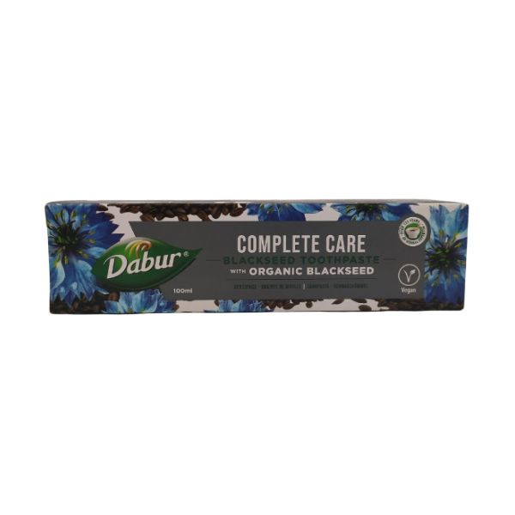
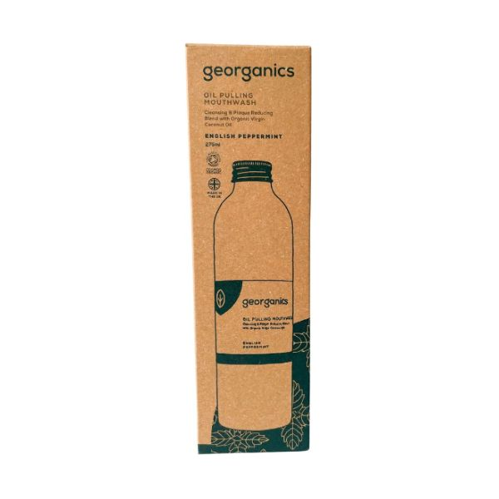
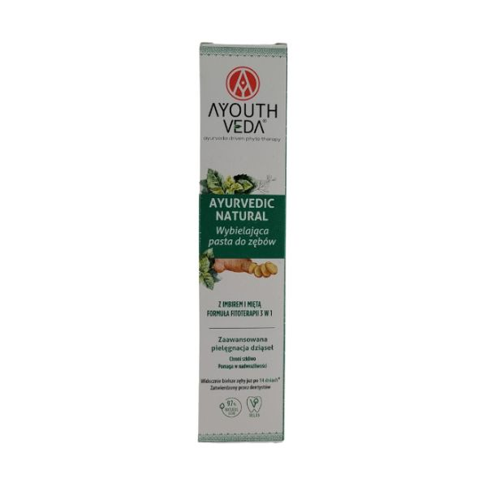
Ancient practices inspire new products
Brands are taking different approaches to Ayurveda, with some relying on ancient practices and others giving them an update.
Seal of approval
Dabur Blackseed Toothpaste contains blackseed for its cleansing and protecting properties, and the product is recommended by The Hungarian Ayurveda Medical Foundation.
Oil pulling
Georganics Oil Pulling Mouthwash draws on the Ayurvedic tradition of oil pulling. The product features peppermint oil as an antibacterial agent and only four other ingredients. The packaging bears the COSMOS Organic logo.
Modernising Ayurveda
Ayouthveda Whitening Toothpaste combines Ayurvedic traditions with modern technology. The product claims to whiten teeth with phytotherapy, which also helps prevent tooth decay.
Read on mintel.com
Notes:
This slide is from A year of innovation in oral care, 2024 (https://clients.mintel.com/content/report/a-year-of-innovation-in-oral-care-2024#workspace_SpacesStore_cfa1623d-6830-49d5-8bfa-1e79969d57a7)
© 2024 Mintel Group Ltd. All Rights Reserved. Confidential to Mintel.

Slide 15
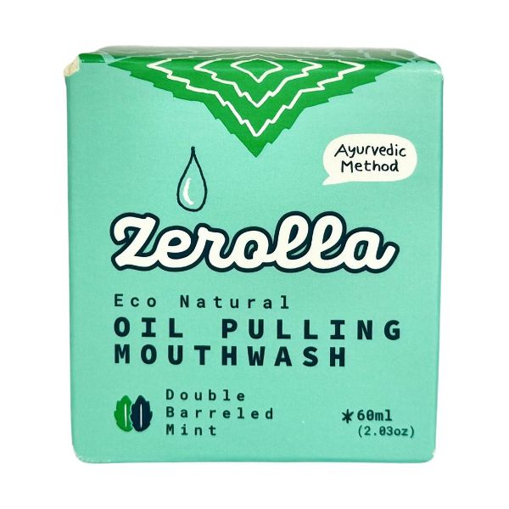
Brand innovation: Zerolla
European consumers are ingredient-conscious – 24% of UK toothpaste users research the ingredients in oral care products. This signals interest in more ingredient transparency.
Zerolla is a UK brand committed to using natural ingredients for oral health benefits. The brand's product line-up includes toothpaste (in powder or tablet format), mouthwash tablets, floss and eco-friendly toothbrushes. Zerolla's Oil Pulling Mouthwash draws upon Ayurvedic traditions to benefit the oral microbiome.
The brand's website offers insight into the natural ingredients it uses, including xylitol sourced from birch bark, peppermint essential oil and calcium fluoride. This open approach will resonate with consumers who are wary about the ingredients used in oral care products.
Zerolla Oil Pulling Mouthwash
Read on mintel.com
Notes:
This slide is from A year of innovation in oral care, 2024 (https://clients.mintel.com/content/report/a-year-of-innovation-in-oral-care-2024#workspace_SpacesStore_881181e1-74e4-44d9-a2b4-b94f89f777b3)
© 2024 Mintel Group Ltd. All Rights Reserved. Confidential to Mintel.

Slide 16
The Middle East & Africa (MEA)
Read on mintel.com
Notes:
This slide is from A year of innovation in oral care, 2024 (https://clients.mintel.com/content/report/a-year-of-innovation-in-oral-care-2024#workspace_SpacesStore_bf7e62dc-24b4-4ddf-a44f-7f0349f8f596)
© 2024 Mintel Group Ltd. All Rights Reserved. Confidential to Mintel.

Slide 17
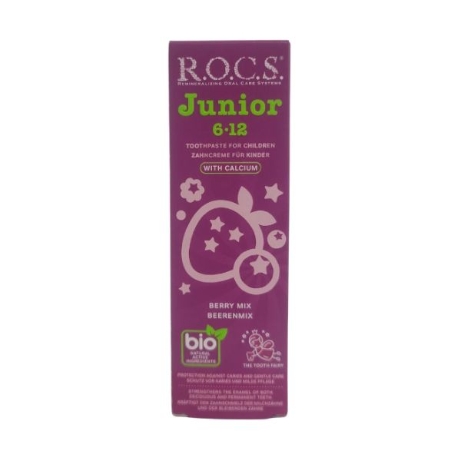
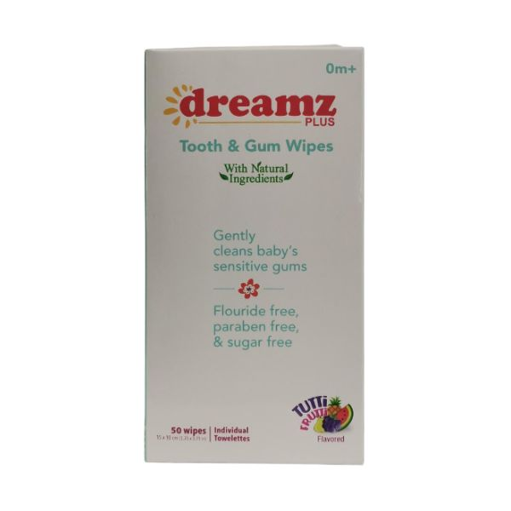
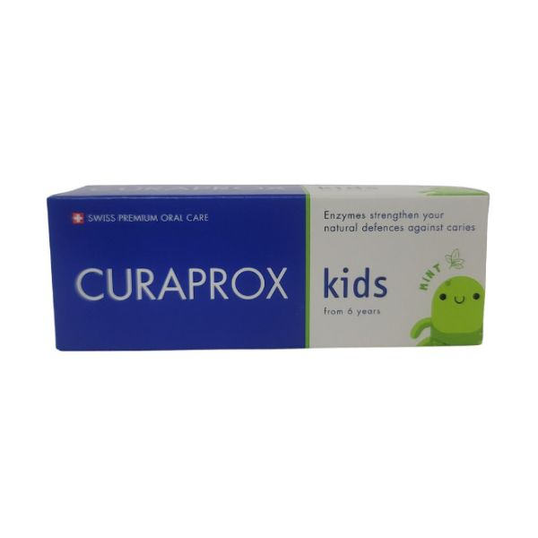
A focus on children's oral health
Child-specific claims are rising, and brands are making dental hygiene appealing to a younger audience.
Tooth-fairy-approved
R.O.C.S Junior Toothpaste is designed for the transition from primary to permanent teeth and plays into stories of the tooth fairy with an image on pack. Aspen bark double extract is used to prevent inflammation.
Suitable for newborns
Dreamz Plus Tooth & Gum Wipes can be used from birth to establish a child's oral hygiene regimen. The wipes soothe and clean teeth and gums.
Microbiome-friendly
Curaprox Kids Toothpaste calls out that it is Swiss-made. The product targets the oral microbiome with enzymes, which the brand claims strengthens the mouth's natural defences against cavities.
Read on mintel.com
Notes:
This slide is from A year of innovation in oral care, 2024 (https://clients.mintel.com/content/report/a-year-of-innovation-in-oral-care-2024#workspace_SpacesStore_40bf94b7-c4d5-4d65-b061-25bb18381e6a)
© 2024 Mintel Group Ltd. All Rights Reserved. Confidential to Mintel.

Slide 18

Asia Pacific (APAC)
Read on mintel.com
Notes:
This slide is from A year of innovation in oral care, 2024 (https://clients.mintel.com/content/report/a-year-of-innovation-in-oral-care-2024#workspace_SpacesStore_b387cb73-ed3f-4e88-84f5-8dc72046895b)
© 2024 Mintel Group Ltd. All Rights Reserved. Confidential to Mintel.

Slide 19
Asia: longevity gains momentum
Read on mintel.com
Notes:
This slide is from A year of innovation in oral care, 2024 (https://clients.mintel.com/content/report/a-year-of-innovation-in-oral-care-2024#workspace_SpacesStore_10d8759f-7bc4-4c4b-8b7a-a40440323ae4)
© 2024 Mintel Group Ltd. All Rights Reserved. Confidential to Mintel.

Slide 20
Long-lasting claims will propose convenience
Maintaining a thorough oral care routine can be taxing. While some consumers may be willing to consistently commit to oral care maintenance multiple times a day, long-lasting products could take the pressure off consumers and allow them to focus on their oral care just twice daily.
Brands can offer products that protect teeth from harmful acids and promise fresh breath, as fears around these issues could prompt consumers to care for their teeth throughout the day.
Some claims that deliver all-day benefits could also help consumers in the long term. For example, a product could nourish the oral microbiome to keep bad breath at bay while also protecting against issues such as gingivitis. Brands that acknowledge such dual benefits will propose value to consumers.
Time-consuming
27%
of Japanese adults say maintaining a good oral care routine takes a lot of time and effort
Base: Japan: 2,000 internet users aged 18+
Source: Rakuten Insight/Mintel, September 2023
Read on mintel.com
Notes:
Source: Rakuten Insight/Mintel, September 2023
This slide is from A year of innovation in oral care, 2024 (https://clients.mintel.com/content/report/a-year-of-innovation-in-oral-care-2024#workspace_SpacesStore_6c28f995-9406-41fa-8bd7-ad43bb4f02ee)
© 2024 Mintel Group Ltd. All Rights Reserved. Confidential to Mintel.

Slide 21
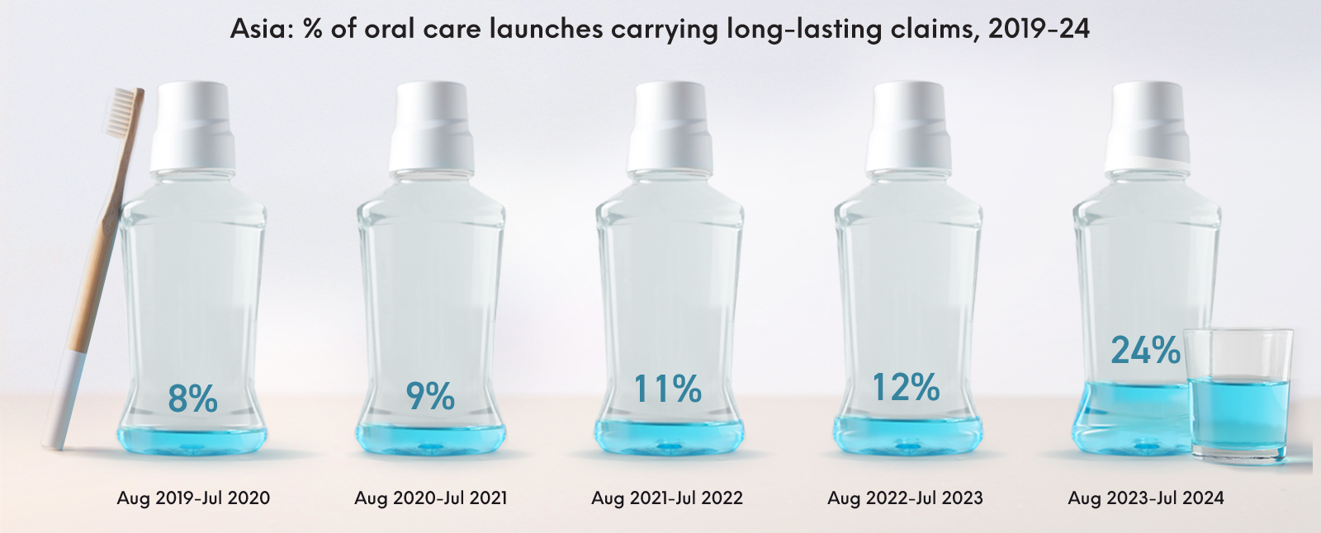
A leap in long-lasting launches
Source: Mintel GNPD, August 2019-July 2024
Read on mintel.com
Notes:
Source: Mintel GNPD, August 2019-July 2024 [1]
[1] https://www.gnpd.com/sinatra/shared_link/1b456125-3a88-48e1-b370-1903cff7d8c4
This slide is from A year of innovation in oral care, 2024 (https://clients.mintel.com/content/report/a-year-of-innovation-in-oral-care-2024#workspace_SpacesStore_20de08ca-35ff-43aa-815c-79dc67313a22)
© 2024 Mintel Group Ltd. All Rights Reserved. Confidential to Mintel.

Slide 22
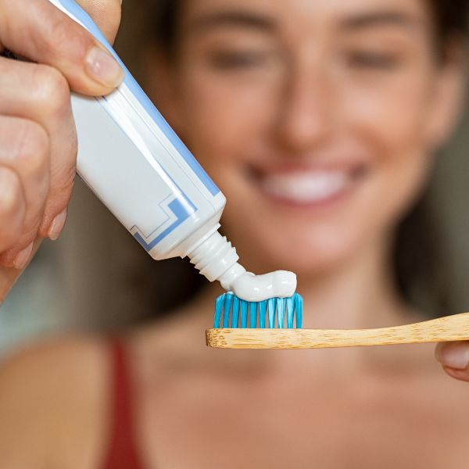
A leap in long-lasting launches
In the year to July 2024, the percentage of oral care launches carrying long-lasting claims increased 12 percentage points, compared to the year prior.
'Long-lasting' in the context of oral care launches refers to a variety of benefits, including breath freshening, protection against sensitivity and whitening.
These examples highlight the versatility of a long-lasting claim and how it can be used in conjunction with other existing claims that already interest consumers, appealing to various purchase priorities.
Brands that quantify how long-lasting a product is in hours, or even weeks, will stand out.
Source: Mintel GNPD, August 2019-July 2024
Read on mintel.com
Notes:
Source: Mintel GNPD, August 2019-July 2024 [1]
[1] https://www.gnpd.com/sinatra/shared_link/1b456125-3a88-48e1-b370-1903cff7d8c4
This slide is from A year of innovation in oral care, 2024 (https://clients.mintel.com/content/report/a-year-of-innovation-in-oral-care-2024#workspace_SpacesStore_71438b0d-4005-441d-bd46-13218485d24a)
© 2024 Mintel Group Ltd. All Rights Reserved. Confidential to Mintel.

Slide 23
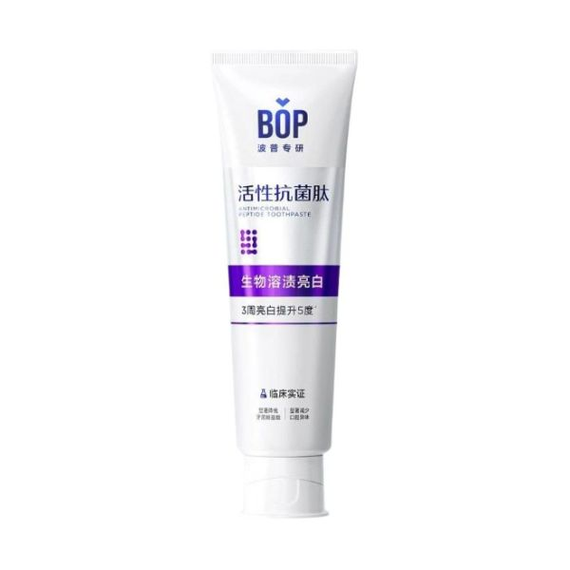
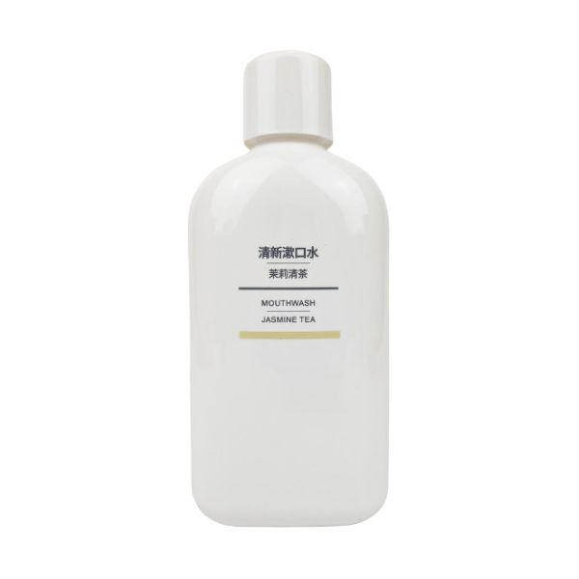
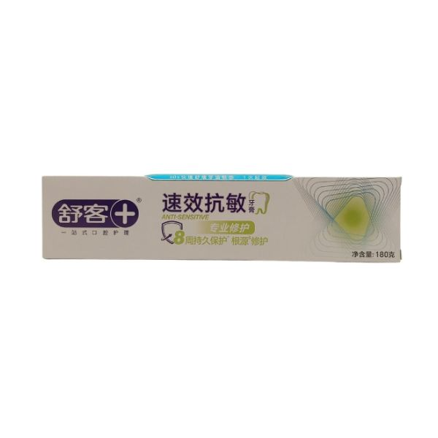
Long-lasting launches appeal to consumers
Long-lasting claims around fresh breath and tooth protection provide consumers with reassurance that they are constantly protecting their oral health.
Peptide power
BOP Bio-Soluble Whitening Toothpaste uses an antimicrobial peptide that provides antibacterial protection for 12 hours. The toothpaste also whitens and removes stains.
Banishing bacteria
Muji Jasmine Tea Mouthwash contains enzymes that reduce odour-causing bacteria for up to 12 hours. The mouthwash also suppresses the growth of Porphyromonas gingivalis, which can cause bad breath.
Providing protection
Shu-Ke Professional Repair Toothpaste claims to offer eight weeks of protection against teeth sensitivity, with a repairing formula that is said to provide these benefits after just one use.
Read on mintel.com
Notes:
This slide is from A year of innovation in oral care, 2024 (https://clients.mintel.com/content/report/a-year-of-innovation-in-oral-care-2024#workspace_SpacesStore_07df4ac7-8869-4e8e-b073-94f8ee44b81c)
© 2024 Mintel Group Ltd. All Rights Reserved. Confidential to Mintel.

Slide 24
Asia: probiotic launches nourish the oral microbiome
Read on mintel.com
Notes:
This slide is from A year of innovation in oral care, 2024 (https://clients.mintel.com/content/report/a-year-of-innovation-in-oral-care-2024#workspace_SpacesStore_ed193c00-c59e-4585-9c7e-402c4641b39e)
© 2024 Mintel Group Ltd. All Rights Reserved. Confidential to Mintel.

Slide 25
Consumers are pro-probiotics
A healthy oral microbiome is essential to good oral health as it can help prevent issues like gum disease, bad breath, cavities and even respiratory infections. Poor oral health has also been linked to problems like pneumonia and cardiovascular disease.
Consumers are familiar with the concept of microbiome health thanks to knowledge around the gut microbiome. This knowledge is reflected in the interest in foods that boost gut health.
Brands can respond to consumer interest in oral microbiome health with the inclusion of pre- and probiotic ingredients in oral care launches. This will help consumers reap immediate benefits, such as fresh breath, as well as long-term benefits, as the inclusion of these ingredients can protect against possible future oral health issues.
good bacteria
20%
of Indian adults would be willing to pay more for an oral care product that contained pre-/probiotic ingredients
Base: India: 3,000 adults aged 18+
Source: Ipsos Observer/Mintel, January 2024
Read on mintel.com
Notes:
Source: Ipsos Observer/Mintel, January 2024
This slide is from A year of innovation in oral care, 2024 (https://clients.mintel.com/content/report/a-year-of-innovation-in-oral-care-2024#workspace_SpacesStore_34d31c38-b50d-492c-8622-323c7f9f1de7)
© 2024 Mintel Group Ltd. All Rights Reserved. Confidential to Mintel.

Slide 26
Lactobacillus-containing NPD rises
Brands are responding to consumer interest in the oral microbiome with launches featuring probiotic claims.
Some oral care brands have already begun to respond to the interest in the oral microbiome with launches featuring probiotic claims. To increase the appeal of these products, brands can explore packaging that educates consumers on the importance of a healthy oral microbiome.
Source: Mintel GNPD, August 2018-July 2024
Read on mintel.com
Notes:
Source: Mintel GNPD, August 2018-July 2024 [1]
[1] https://www.gnpd.com/sinatra/shared_link/c32e2157-a1fe-43c7-9b30-004ff553f4ac
This slide is from A year of innovation in oral care, 2024 (https://clients.mintel.com/content/report/a-year-of-innovation-in-oral-care-2024#workspace_SpacesStore_3fbbca11-8c22-4160-a15b-b1fdb719be41)
© 2024 Mintel Group Ltd. All Rights Reserved. Confidential to Mintel.

Slide 27
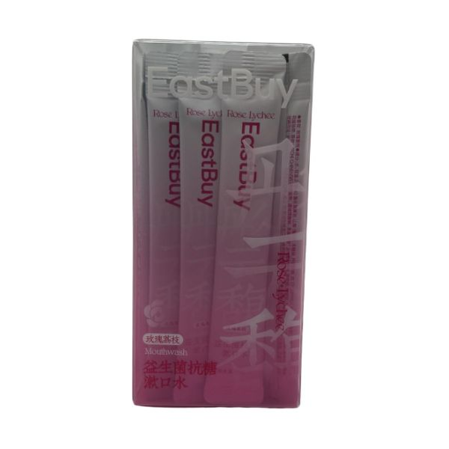
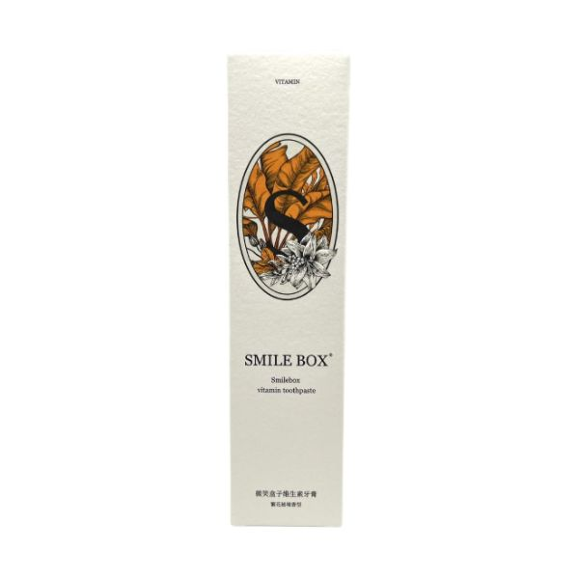
Buying into the microbiome
Brands are helping consumers nourish their oral microbiome, alongside offering other specific benefits, like breath freshening.
On the go
EastBuy Probiotic Anti-Glycation Mouthwash makes on-the-go oral care easy with individual mouthwash sachets. The product contains Lactobacillus and glucanase to balance the oral microbiome.
Patented power
Smile Box Vitamin Toothpaste uses a patented antibacterial agent to freshen breath. Meanwhile, a patented probiotic powder helps to stabilise the oral microbiome.
Teeth tech
NVR Probiotics & Enzymes Whitening Toothpaste contains probiotics to balance the oral microbiome and freshen breath. The toothpaste uses micro-capsule technology to ensure ingredients remain effective.
Read on mintel.com
Notes:
This slide is from A year of innovation in oral care, 2024 (https://clients.mintel.com/content/report/a-year-of-innovation-in-oral-care-2024#workspace_SpacesStore_88fcd317-663f-45bb-b83a-bb8b794542a2)
© 2024 Mintel Group Ltd. All Rights Reserved. Confidential to Mintel.

Slide 28
Australia & New Zealand: a spotlight on fast-acting formulas
Read on mintel.com
Notes:
This slide is from A year of innovation in oral care, 2024 (https://clients.mintel.com/content/report/a-year-of-innovation-in-oral-care-2024#workspace_SpacesStore_0e17071b-33fd-4e32-a73a-7b24d8a57217)
© 2024 Mintel Group Ltd. All Rights Reserved. Confidential to Mintel.

Slide 29
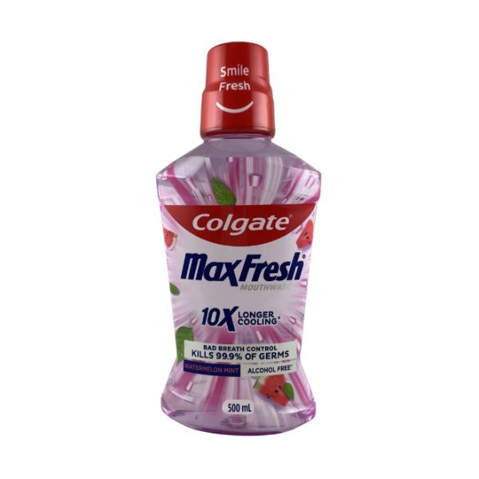
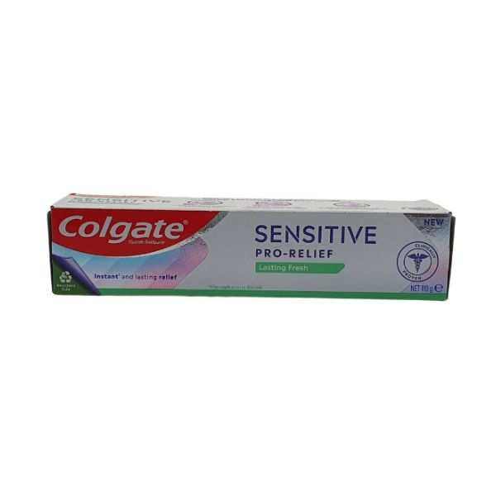
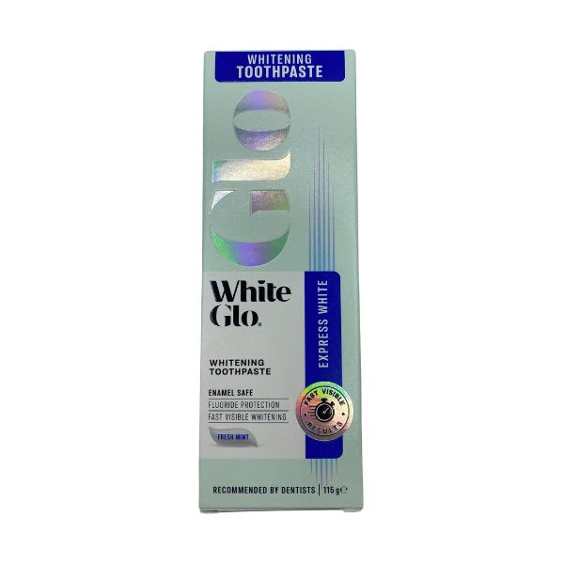
ANZ consumers have a need for speed
Time/speed claims in oral care increased in Australia and New Zealand in the year to July 2024 as brands catered to consumers wanting quick results.
Breath freshening
Colgate MaxFresh Watermelon Mint Mouthwash claims to instantly freshen breath and maintain it for up to 24 hours. The mouthwash is alcohol-free and features a watermelon-mint flavour.
Treats sensitivity
Colgate Sensitive Pro-Relief Toothpaste offers instant relief for sensitivity with Pro-Argin technology, blocking exposed dentine tubules that can cause sensitivity.
All-rounder
White Glo Whitening Toothpaste gives visible results quickly, while ensuring teeth stay healthy with an enamel-safe formula that protects against cavities and decay, ensures gum health and freshens breath.
Read on mintel.com
Notes:
This slide is from A year of innovation in oral care, 2024 (https://clients.mintel.com/content/report/a-year-of-innovation-in-oral-care-2024#workspace_SpacesStore_640a1b10-9196-4710-8eca-d75eaad1d084)
© 2024 Mintel Group Ltd. All Rights Reserved. Confidential to Mintel.

Slide 30

The Americas
Read on mintel.com
Notes:
This slide is from A year of innovation in oral care, 2024 (https://clients.mintel.com/content/report/a-year-of-innovation-in-oral-care-2024#workspace_SpacesStore_44cf1d49-670b-48fb-813c-90a1d53ae4ac)
© 2024 Mintel Group Ltd. All Rights Reserved. Confidential to Mintel.

Slide 31
North America: a trend of premiumisation
Read on mintel.com
Notes:
This slide is from A year of innovation in oral care, 2024 (https://clients.mintel.com/content/report/a-year-of-innovation-in-oral-care-2024#workspace_SpacesStore_d06b9215-69ba-45b3-96d7-42ee77a90185)
© 2024 Mintel Group Ltd. All Rights Reserved. Confidential to Mintel.

Slide 32
Premium oral care appeals to consumers
Oral health is a priority for North American adults, reflected in their willingness to pay for premium products. The appeal of premium products is bolstered by the cost of dental appointments, prompting consumers to invest in at-home preventative care.
To justify high price points, brands can hone in on consumer priorities like whitening, strengthening and breath freshening, while partnering with dentists to prove expertise.
Considering the high cost of whitening procedures, brands can also blur the lines between at-home and cosmetic dentistry by comparing the results of whitening products to that of professional treatments.
Investment in oral care
69%
of US oral care product users prefer to invest in professional-grade/premium products
Base: US: 1,963 internet users aged 18+ who use oral care products
Source: Kantar Profiles/Mintel, June 2024
Read on mintel.com
Notes:
Source: Kantar Profiles/Mintel, June 2024
This slide is from A year of innovation in oral care, 2024 (https://clients.mintel.com/content/report/a-year-of-innovation-in-oral-care-2024#workspace_SpacesStore_8d2cea05-ef43-4404-9d59-437ab3a4889c)
© 2024 Mintel Group Ltd. All Rights Reserved. Confidential to Mintel.

Slide 33
Prices of oral care are increasing
In the year to July 2024, fewer North American oral care launches cost less than $11.74 compared to previous years, and the category saw a flurry of premium NPD.
Whitening claims have become more prevalent as prices have increased, featuring on 33% of launches under $11.74 and 85% of launches between $22.75 and $33.74. Premium brands are focusing on consumer priorities around aesthetics and competing with both at-home and clinical whitening procedures.
Totals may not sum due to rounding
Source: Mintel GNPD, August 2019-July 2024
Read on mintel.com
Notes:
Totals may not sum due to rounding
Source: Mintel GNPD, August 2019-July 2024 [1]
[1] https://www.gnpd.com/sinatra/shared_link/7a0428df-bdfb-4606-be51-799107c7cf82
This slide is from A year of innovation in oral care, 2024 (https://clients.mintel.com/content/report/a-year-of-innovation-in-oral-care-2024#workspace_SpacesStore_70c842eb-465c-4d84-b836-3c90c0e6f57a)
© 2024 Mintel Group Ltd. All Rights Reserved. Confidential to Mintel.

Slide 34
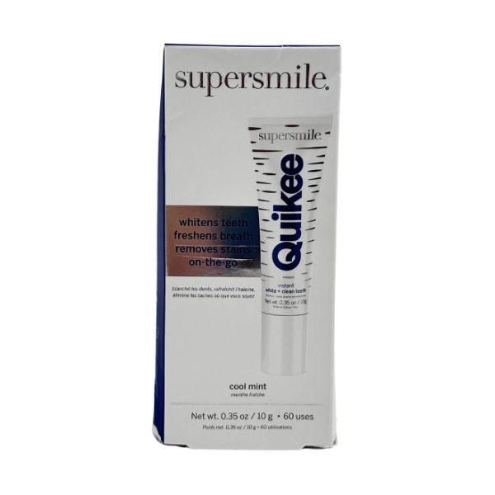
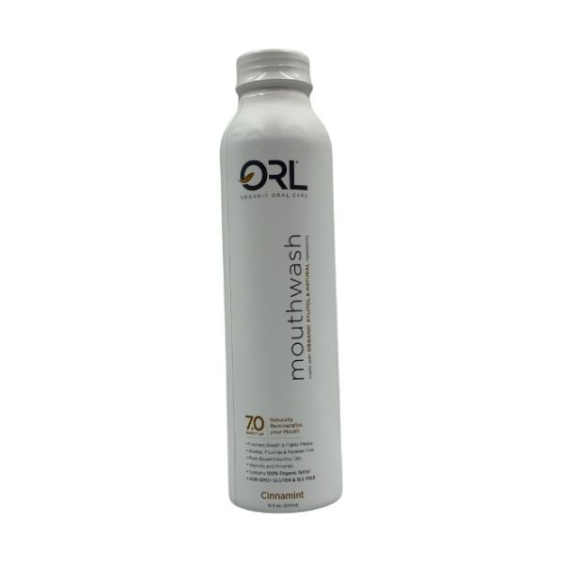
Encourage investment in oral care
Brands are justifying premium price points by featuring dentist-formulated claims and blurring the lines between oral care, healthcare and beauty.
Dentist-approved
Quikee Supersmile Instant White + Clean Teeth offers teeth-whitening and breath-freshening benefits on the go. The brand was created by Dr Irwin Smigel, dubbed the father of aesthetic dentistry.
Beauty meets oral care
Moon Teeth Whitener & Lip Brightener blurs beauty with oral care. The dual-ended teeth whitener/lip gloss incorporates an antioxidant blend to gently whiten teeth and uses vitamin E to moisturise lips.
Natural alternatives
ORL Mouthwash contains organic xylitol as a fluoride alternative to help fight tooth decay and freshen breath, while vitamin C helps protect against gingivitis. The product is designed to keep the pH of the mouth stable.
Read on mintel.com
Notes:
This slide is from A year of innovation in oral care, 2024 (https://clients.mintel.com/content/report/a-year-of-innovation-in-oral-care-2024#workspace_SpacesStore_646d6df5-90b6-4caa-87a7-ab925eceadc0)
© 2024 Mintel Group Ltd. All Rights Reserved. Confidential to Mintel.

Slide 35
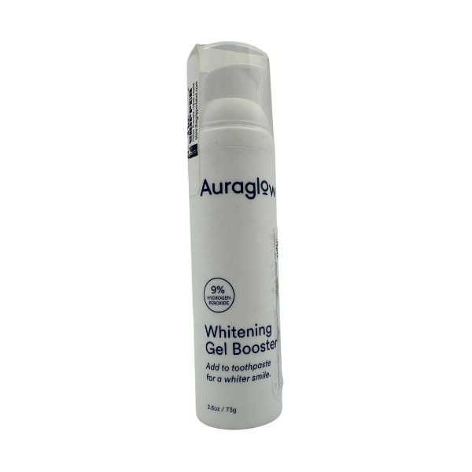
Brand renovation: Auraglow
Auraglow's hero product is its affordable LED whitening kit, which can be used with gels of varying strengths. The brand also offers whitening pens.
In 2024, the brand expanded its range to include Auraglow Whitening Gel Booster. The everyday product can maintain the whiteness achieved through at-home whitening treatments, or it can be used alone.
Designed to be added to toothpaste, the 9% hydrogen peroxide formula helps lift stains and whiten teeth. The brand justifies the premium price point on its website by assuring that the product lasts six months if used twice daily.
The booster format is relatively new to the category and will appeal to consumers who prioritise aesthetically pleasing, white teeth.
Auraglow Whitening Gel Booster
Read on mintel.com
Notes:
This slide is from A year of innovation in oral care, 2024 (https://clients.mintel.com/content/report/a-year-of-innovation-in-oral-care-2024#workspace_SpacesStore_4f952467-7575-4ced-ab14-acc3d9e8adf3)
© 2024 Mintel Group Ltd. All Rights Reserved. Confidential to Mintel.

Slide 36
North America: consumers scrutinise ingredient lists
Read on mintel.com
Notes:
This slide is from A year of innovation in oral care, 2024 (https://clients.mintel.com/content/report/a-year-of-innovation-in-oral-care-2024#workspace_SpacesStore_c3799609-571e-45f4-82bb-522a61c9f472)
© 2024 Mintel Group Ltd. All Rights Reserved. Confidential to Mintel.

Slide 37
Appeal to ingredient-conscious consumers
North American adults are ingredient-conscious, as 69% have purchased what they consider to be 'clean' oral care products in the year to September 2023, and clean beauty buyers prioritise 'clean' oral care over 'clean' products in other BPC categories. These attitudes are likely a reflection of fearmongering around fluoride by natural/organic blogs, social media pages or even brands themselves.
Long-term excess fluoride ingestion in childhood can cause issues such as dental fluorosis, characterised by small lines or stains on teeth. High doses may also lead to nausea or skeletal fluorosis, and some studies connect fluoride exposure to neurobehavioural issues, though evidence is debated. However, these effects are not associated with the average intake of fluoride. Nevertheless, some consumers are wary of fluoride, which creates an appetite for alternatives.
clean teeth
27%
of US clean beauty buyers consider oral care to be the most important category for them to purchase 'clean'
Base: US: 1,371 internet users aged 18+ who have used clean oral care in the past 12 months
Source: Kantar Profiles/Mintel, September 2023
Read on mintel.com
Notes:
Source: Kantar Profiles/Mintel, September 2023
This slide is from A year of innovation in oral care, 2024 (https://clients.mintel.com/content/report/a-year-of-innovation-in-oral-care-2024#workspace_SpacesStore_af568f94-c598-4a1a-8119-e0f7f1e96233)
© 2024 Mintel Group Ltd. All Rights Reserved. Confidential to Mintel.

Slide 38
Explore fluoride alternatives
Hydroxyapatite is often touted by oral care brands as a fluoride alternative.
It is a mineral naturally found in bones and teeth. When used in toothpaste, it serves to remineralise teeth, strengthen tooth enamel and can aid in filling microdefects to reduce sensitivity.
The ingredient has primarily been used by smaller oral care brands, like Bite and Terra & Co, for which a brand selling point is based on the exclusion of controversial ingredients.
Source: Mintel GNPD, August 2019-July 2024
Read on mintel.com
Notes:
Source: Mintel GNPD, August 2019-July 2024 [1]
[1] https://www.gnpd.com/sinatra/shared_link/a0550413-8a22-4172-96b8-1a4831b83339
This slide is from A year of innovation in oral care, 2024 (https://clients.mintel.com/content/report/a-year-of-innovation-in-oral-care-2024#workspace_SpacesStore_4131c06d-659c-4464-af8e-2f30ac0e8f29)
© 2024 Mintel Group Ltd. All Rights Reserved. Confidential to Mintel.

Slide 39
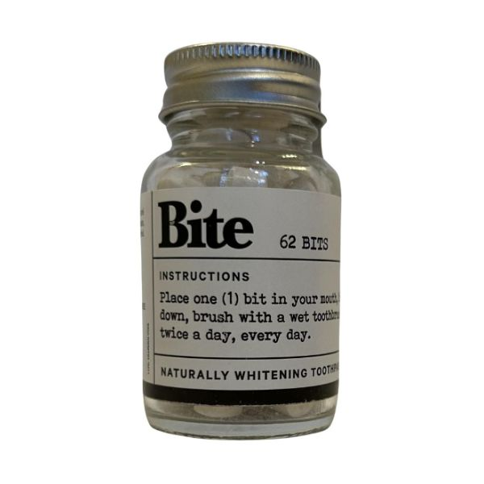
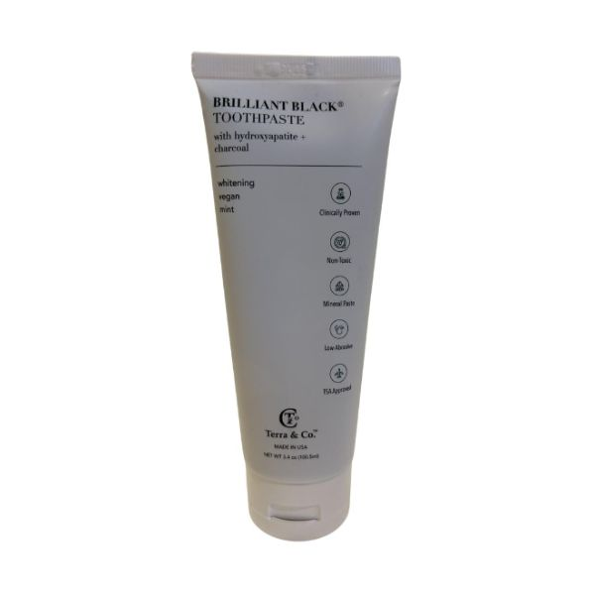
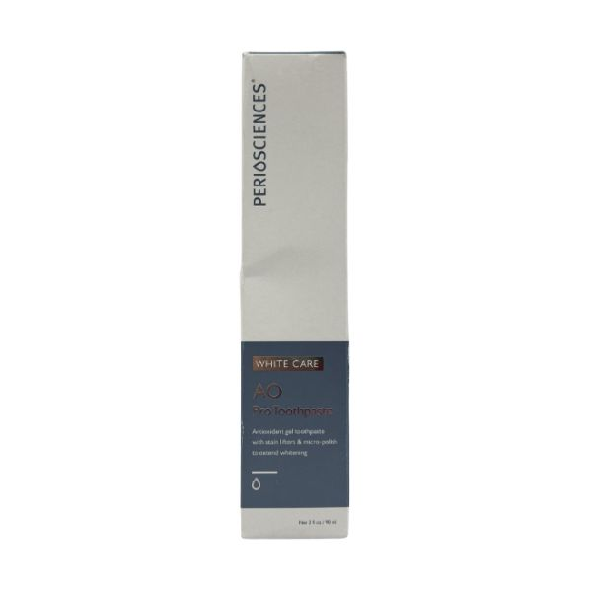
An appetite for hydroxyapatite
Brands are emphasising the efficacy of rarely used hydroxyapatite on pack to reassure consumers of the ingredient's efficacy.
Fluoride fears
Bite Naturally Whitening Toothpaste Bits appeal to consumers wary of fluoride with a claim that nano-hydroxyapatite is a non-toxic fluoride alternative. The solid toothpaste tablets come in plastic-free packaging.
Emphasising efficacy
Terra & Co. Brilliant Black Toothpaste Toothpaste bears clinically proven and toxin-free claims, among others, on pack. The packaging also calls out hydroxyapatite as protecting against tooth enamel erosion.
Double trouble
PerioSciences AO White Care ProToothpaste uses both sodium fluoride and hydroxyapatite as a follow-up treatment to at-home and professional whitening treatments. The product claims to fight cavities and strengthen teeth.
Read on mintel.com
Notes:
This slide is from A year of innovation in oral care, 2024 (https://clients.mintel.com/content/report/a-year-of-innovation-in-oral-care-2024#workspace_SpacesStore_d742d260-3d8d-4390-b7a1-bc9cc71acd26)
© 2024 Mintel Group Ltd. All Rights Reserved. Confidential to Mintel.

Slide 40
Latin America: green innovation
Read on mintel.com
Notes:
This slide is from A year of innovation in oral care, 2024 (https://clients.mintel.com/content/report/a-year-of-innovation-in-oral-care-2024#workspace_SpacesStore_19512bbf-9c98-4844-8d08-0334047a0a5e)
© 2024 Mintel Group Ltd. All Rights Reserved. Confidential to Mintel.

Slide 41
Green claims continue to grow in Latin America
While they have plateaued, environmentally friendly packaging claims remain common in Latin American oral care launches. This reflects how brands have been responding to consumer interest in sustainability. Indeed, in Brazil, 32% of personal hygiene product users rank eco-friendly packaging in their top three purchase priorities.
As environmentally friendly packaging claims become more common, brands can differentiate and stand out to eco-conscious consumers with less common environmental claims. For example, biodegradable, refillable and carbon neutral claims featured on just 1.9%, 0.8% and 0.3% of Latin American oral care launches, respectively, in the year to July 2024.
Source: Mintel GNPD, August 2018-July 2024
Read on mintel.com
Notes:
Source: Mintel GNPD, August 2018-July 2024 [1]
[1] https://www.gnpd.com/sinatra/shared_link/72fcd896-75b7-4673-9b67-467204ef3ff7
This slide is from A year of innovation in oral care, 2024 (https://clients.mintel.com/content/report/a-year-of-innovation-in-oral-care-2024#workspace_SpacesStore_1b7da223-6d84-4766-adbe-0835d383d000)
© 2024 Mintel Group Ltd. All Rights Reserved. Confidential to Mintel.

Slide 42
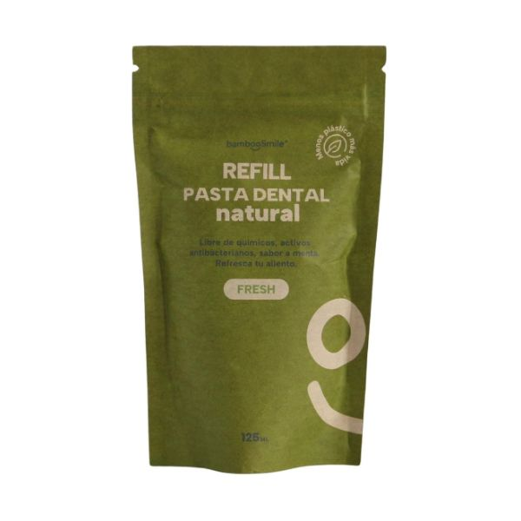
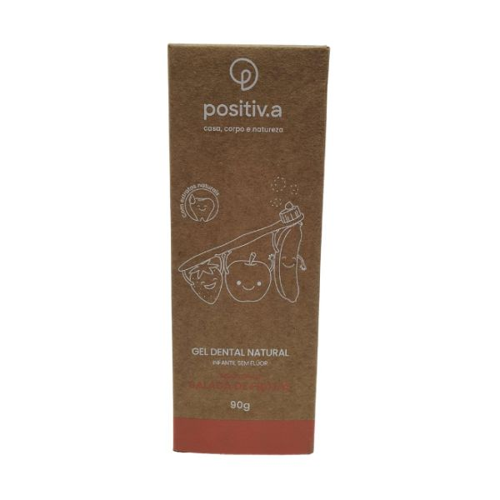
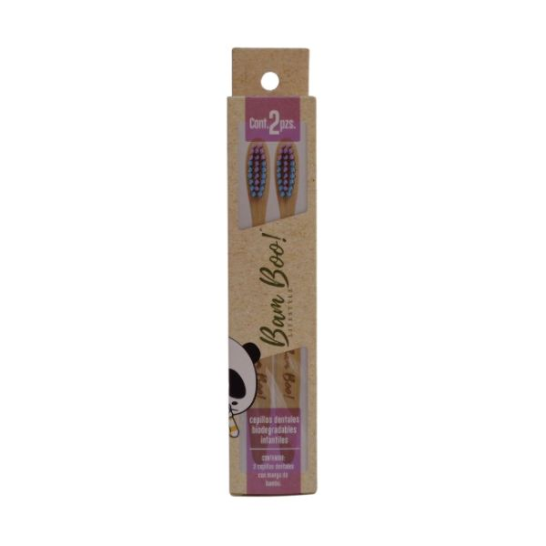
Distinguish with niche eco claims
Brands are distinguishing themselves by going beyond recyclable packaging claims with niche eco claims, like biodegradable and refillable.
Refillable
BambooSmile Fresh Natural Toothpaste Refill involves less plastic than traditional toothpaste packaging and was the only refillable toothpaste launched in the year to July 2024 in Latin America.
B Corp certified
Positiv.a Children's Natural Dental Gel claims to use the first toothpaste tube made from PCR plastic in Brazil. The packaging is also recyclable and showcases the brand's B Corp certification.
Biodegradable
Bam Boo! Lifestyle Biodegradable Toothbrush for Kids features a biodegradable handle and the outer packaging is recyclable.
Read on mintel.com
Notes:
This slide is from A year of innovation in oral care, 2024 (https://clients.mintel.com/content/report/a-year-of-innovation-in-oral-care-2024#workspace_SpacesStore_1e0fdf38-e1ec-4b8a-9ab9-22b269609128)
© 2024 Mintel Group Ltd. All Rights Reserved. Confidential to Mintel.

Slide 43
Georgia Stafford
Beauty & Personal Care Analyst
gstafford@mintel.com

